Slide 1
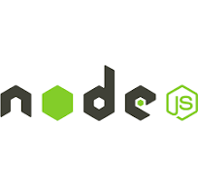

FULL STACK APPLICATION DEVELOPMENT
Course Coordinator: Dr Y.Subbarayudu

Slide 2
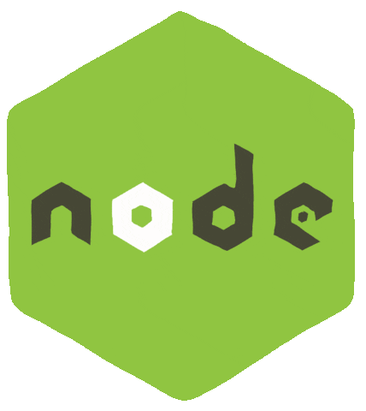

Chapters
FUNDAMENTALS
Node.js Basics
EXPRESS
REST API
REST API Basics
Main Features of Node.js
Project setup & Modules
Top built in modules
Express Basics
Middleware
Types of Middleware's
Routing - I
Routing - II
Template Engines
HTTP Methods & Status Codes
CORS, Serialization, Deserialization, Others
Authentication & Authorization
NODE - OTHERS
15 Error Handling & Debugging
MONGO-DB
23. Application based questions.
18. MongoDB Basics
Security, Performance & Deployment
Testing & Web Socket
Setup & CRUD operations
Query Operators & Projection
Indexes
Mongoose
JavaScript Essentials for Node
Scenario based short questions

Slide 3
1. Node.js - Basics
Q1. What is Node.js?
Q2. How Node is a runtime environment on server side? What is V8?
Q3. What is the difference between Runtime environment & Framework?
Q4. What is the difference between Node.js & Express.js?
Q5. What are the differences between Client-Side(Browser) & Server-Side(Node.js)?
Back to main index

Slide 4




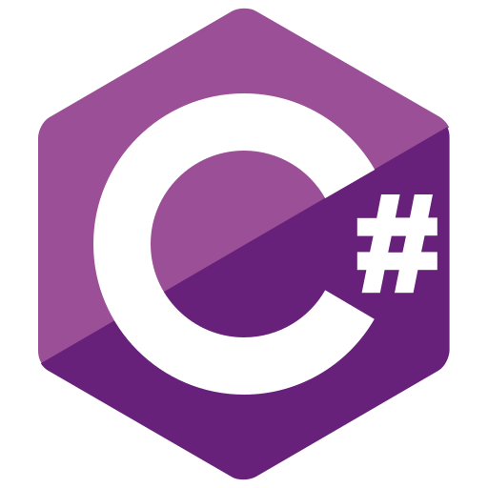




Q. What is Node.js?
Node is neither a language nor a framework.
Node/ Node.js is a runtime environment for executing JavaScript code on the server side.
Languages
Runtime Environment
CPython
JVM
Node.js
CLR
Frameworks
Back to chapter index

Slide 5

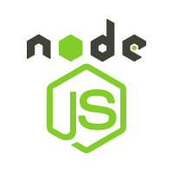


Q. How Node is a runtime environment on server side? What is V8?
Browsers execute JavaScript on the client side, and similarly, Node.js executes JavaScript on the server side.
V8 is a JavaScript engine for the JavaScript language.
Browser(client side)
Node(server side)
JavaScript Engine
JavaScript Engine
Back to chapter index

Slide 6
Q. What is the difference between Runtime environment & Framework?
Runtime Environment: Primarily focuses on providing the necessary infrastructure for code execution, including services like memory management and I/O operations.
Framework: Primarily focuses on simplifying the development process by offering a structured set of tools, libraries, and best practices.
Languages
Runtime Environment
CPython
JVM
Node.js
CLR
Frameworks
Back to chapter index

Slide 7
Q. What is the difference between Node.js & Express.js?
Node.js is a runtime environment that allows the execution of JavaScript code server-side.
Express.js is a framework built on the top Node.js.
  It is designed to simplify the process of building web applications and APIs by providing a set of features like simple routing system, middleware support etc.
Language
Runtime Environment
Node.js
Framework
Back to chapter index

Slide 8



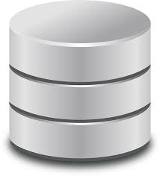

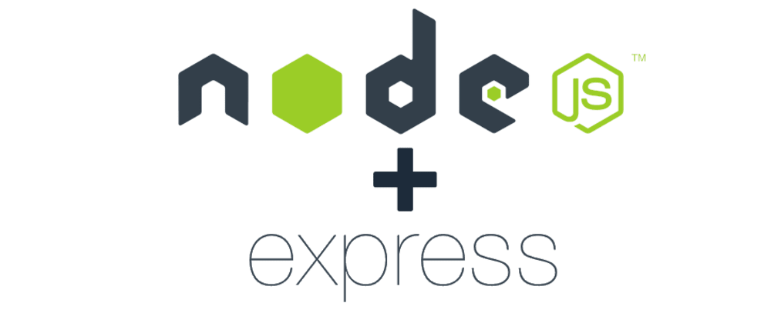


Q. What are the differences between Client-Side(Browser) & Server-Side(Node.js)?
Client-Side
Server-Side
Database Server
Request
Response
Back to chapter index

Slide 9
Q. What are the differences between Client Side(Browser) & Server-Side(Node.js)?
 | Client-Side (Browser) | Server-Side (Node.js/Server)
Environment Location | Runs on the user's web browser. | Runs on the server.
Primary Languages | HTML, CSS, JavaScript. | JavaScript
Document/ Window/ Navigator/ Event Objects | Yes | No
Request/ Response/ Server/ Database Object | No | Yes
Responsibilities | Handles UI display, interactions, and client-side logic. | Handles business logic, data storage/ access, authentication, authorization etc.
Back to chapter index

Slide 10
2. Main Features of Node.js
Q. What are the 7 Main Features of Node.js?
Q. What is Single Threaded Programming?
Q. What is Synchronous Programming?
Q. What is Multi Threaded Programming?
Q. What is Asynchronous Programming?
Q. What is the difference between Synchronous & Asynchronous programming?
Q. What are Events, Event Emitter, Event Queue, Event Loop & Event Driven?
Q. What are the main features & advantages of Node.js?
Q. What are the disadvantages of node?
Back to main index

Slide 11
Q. What are the 7 Main Features of Node.js?
7 Key Features of Node
1. Single Threaded
2. Asynchronous
3. Event-Driven
5. Cross-Platform
7. Real-Time Capabilities
6. NPM (Node Package Manager)
4. V8 JavaScript Engine
Back to chapter index

Slide 12
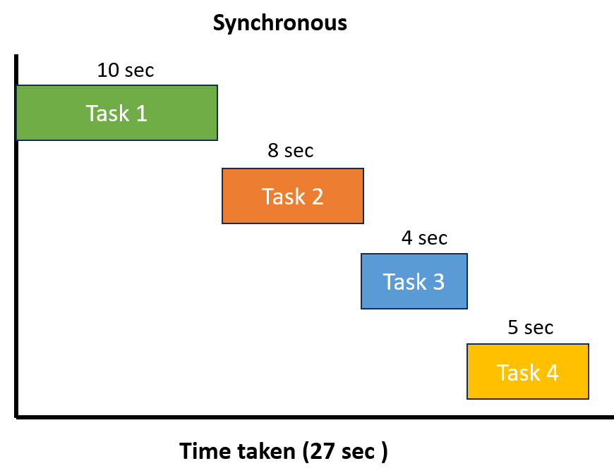
Q. What is Single Threaded Programming?
Client-Side
Server-Side
Request
Single Thread created
In a single-threaded application, only one thread will execute all the tasks.
T1
T1
T1
T1
T1
Back to chapter index

Slide 13
Q. What is Synchronous Programming?
In a synchronous program, each task is performed one after the other, and the program waits for each operation to complete before moving on to the next one.
Synchronous programming focuses on the order of execution in a sequential manner, while single-threaded programming focuses on the single thread.
Single Thread created
T1
T1
T1
T1
T1
Back to chapter index

Slide 14
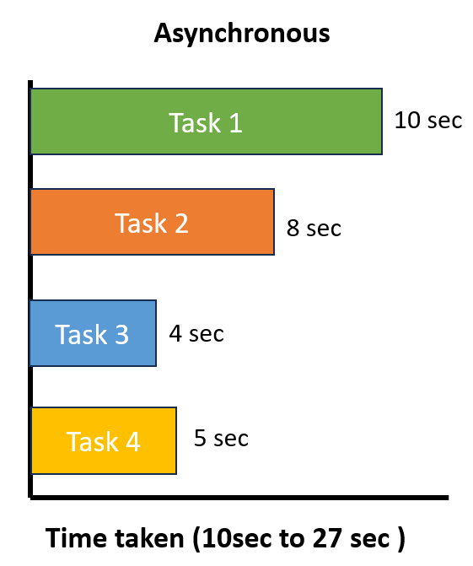
Q. What is Multi Threaded Programming?
Client-Side
Server-Side
Request
T1
In a multi-threaded application, multiple threads can execute multiple tasks simultaneously and parallelly.
As soon as one thread starts a task, the next task is immediately initiated by creating a second thread.
T1
T2 created
T2
T3 created
T3
T4 created
T4
Back to chapter index

Slide 15
Q. What is Asynchronous Programming?
In Node.js, asynchronous flow can be achieved by its single-threaded, non-blocking, and event-driven architecture.
T1
T1
In Node.js, if there are 4 tasks(Task1, Task2, Task3, Task4) to be completed for an event. Then below steps will be executed:
First, Thread T1 will be created.
Thread T1 initiates Task1, but it won't wait for Task1 to complete. Instead, T1 proceeds to initiate Task2, then Task3 and Task4(This asynchronous execution allows T1 to efficiently handle multiple tasks concurrently).
Whenever Task1 completes, an event is emitted.
Thread T1, being event-driven, promptly responds to this event, interrupting its current task and delivering the result of Task1.
T1
T1
T1
Back to chapter index

Slide 16
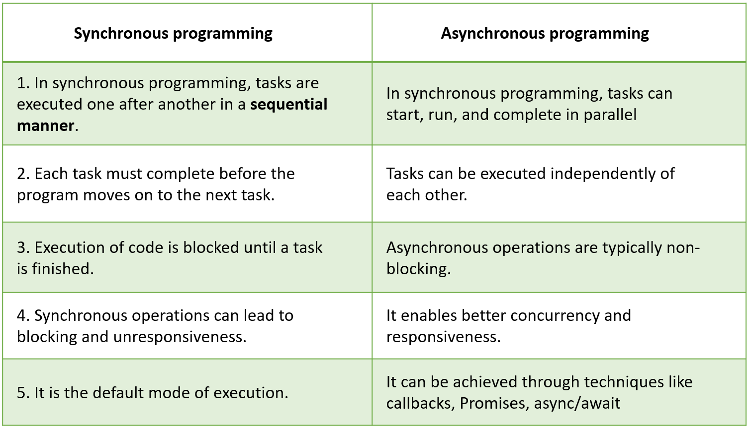

Q. What is the difference between Synchronous & Asynchronous programming?
Back to chapter index

Slide 17
Q. What are Events, Event Emitter, Event Queue, Event Loop & Event Driven?
Event: Signals that something has happened in a program.
Event Emitter: Create or emit events.
Event Queue: Events emitted queued(stored) in event queue.
Event Handler(Event Listener): Function that responds to specific events
Event Loop: The event loop picks up event from the event queue and executes them in the order they were added.
Event Driven Architecture: It means operations in Node are drive or based by events.
Event Emitters
Events Queue
Events Handler
E2
E1
Event Loop
Code
Back to chapter index

Slide 18
Q. What are the main features & advantages of Node.js?
Features
Advantages
1. Asynchronous
Enables handling multiple concurrent requests & non blocking execution of thread.
2. V8 JS Engine
Built on the V8 JS engine from Google Chrome, Node.js executes code fast.
3. Event-Driven Architecture
Efficient handling events. Great for real time applications like chat applications, gaming applications(using web sockets) where bidirectional communication is required.
4. Cross-Platform
Supports deployment on various operating systems, enhancing flexibility.
5. JavaScript
Coding in JS language therefore no need to learn a new language.
Suitable for building scalable applications that can handle increased loads.
Back to chapter index

Slide 19
Q. What are the disadvantages of node? When to use and when not to use Node?
When to Use Node.js?
Ideal for real-time applications like chat applications, online gaming, and collaborative tools due to its event-driven architecture.
Excellent for building lightweight and scalable RESTful APIs that handle a large number of concurrent connections.
Well-suited for building microservices-based architectures, enabling modular and scalable systems.
When not to use Node.js(disadvantages):
CPU-Intensive Tasks: Avoid for applications that involve heavy CPU processing(Image/Video Processing, Data Encryption/Decryption, ) as Node.js may not provide optimal performance in such scenarios because it single threaded and for heavy computation multi-threaded is better.
Back to chapter index

Slide 20
3. Project Setup & Modules
Q. How to setup node.js project?
Q. What is NPM? What is the role of node_modules folder?
Q. What is the role of package.json file in Node?
Q. What are Modules in Node?
Q. How many ways are there to Export a module?
Q. What will happen if you don’t export the module?
Q. How to import single and multiple functions from a module?
Q. What is module wrapper function?
Q. What are the Types of modules in Node?
Back to main index

Slide 21
Q. How to setup node.js project?
7 Steps for setting up node.js project in VS Code:
Download Node.js installer & install it.
Download VSCode editor installer & install it.
Create a new folder (myFirstProject) anywhere.
Open VSCode and open myFirstProject folder from it.
Initialize project: Open terminal & run this command: npm init -y.
Create a new JS file(app.js) within your project folder(myFirstProject).
Run your Node.js application by using this command in the terminal - node app.js.
Back to chapter index

Slide 22
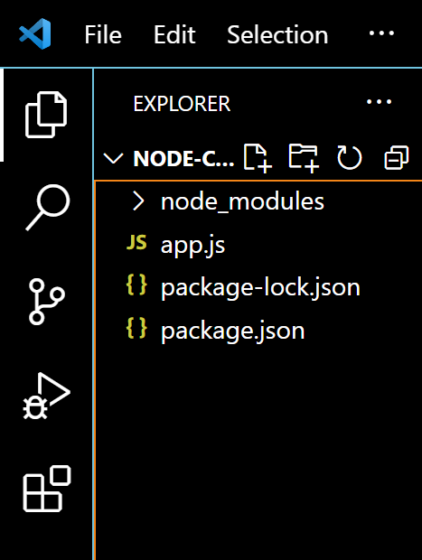
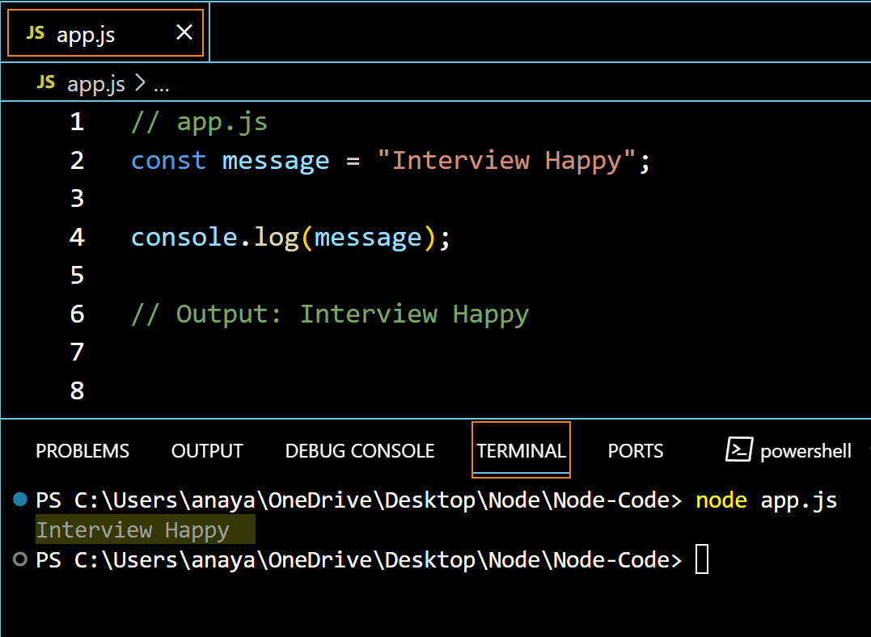
Q. How to setup node.js project?
Back to chapter index

Slide 23
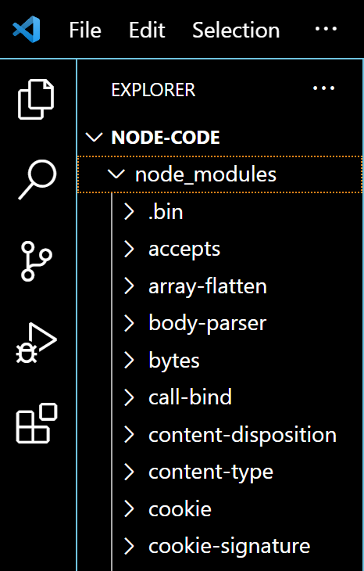
Q. What is NPM? What is the role of node_modules folder?
NPM(Node Package Manager) is used to manage the dependencies for your Node project.
node_modules folder contains all the dependencies of the node project.
Back to chapter index

Slide 24
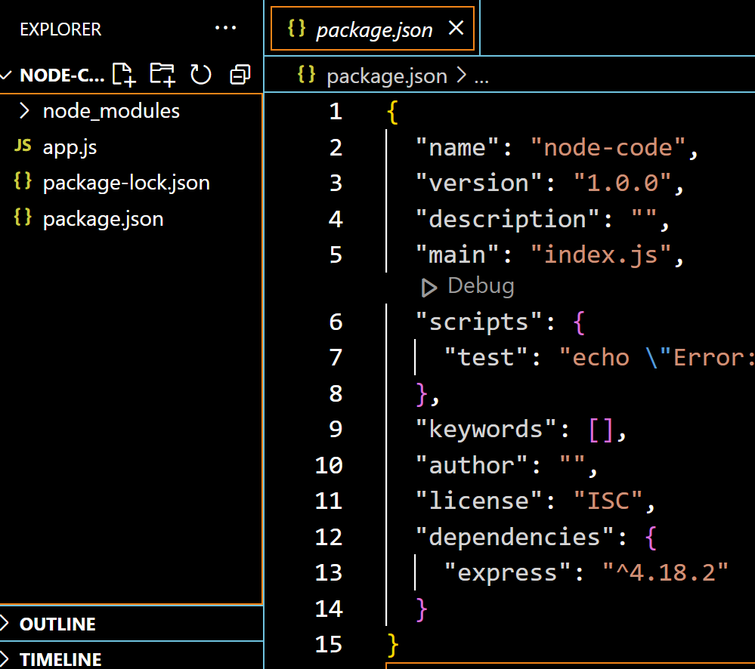
Q. What is the role of package.json file in Node?
The package.json file contains project metadata(information about the project). For example, project name, version, description, author, license etc.
Back to chapter index

Slide 25
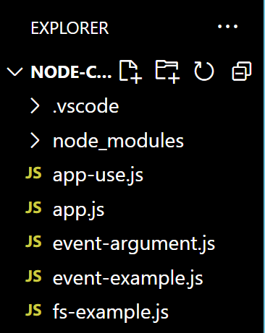
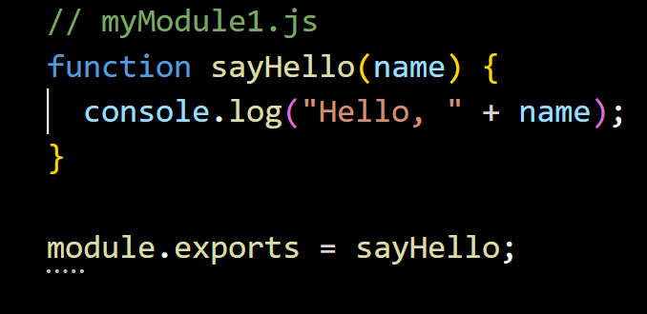
Q. What are Modules in Node? What is the difference between a function & module?
A module contains a specific functionality that can be easily reused within a Node.js application.
Ideally in node.js, a JavaScript file can be treated as a module.
Modules
A module is a broader concept that encapsulates functionality, while a function is a specific set of instructions within that module.
Modules can contain multiple functions and variables.
Back to chapter index

Slide 26
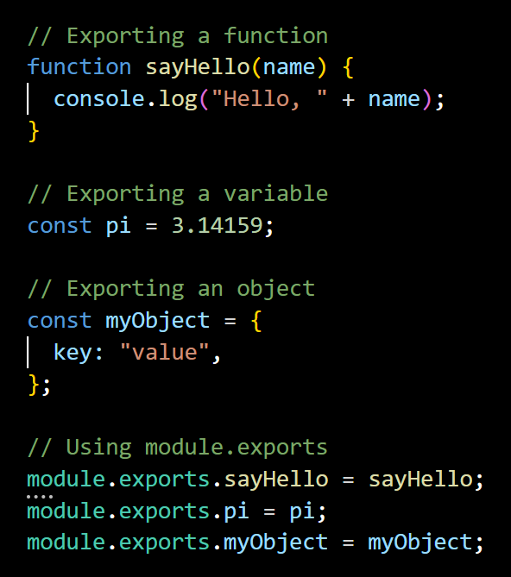
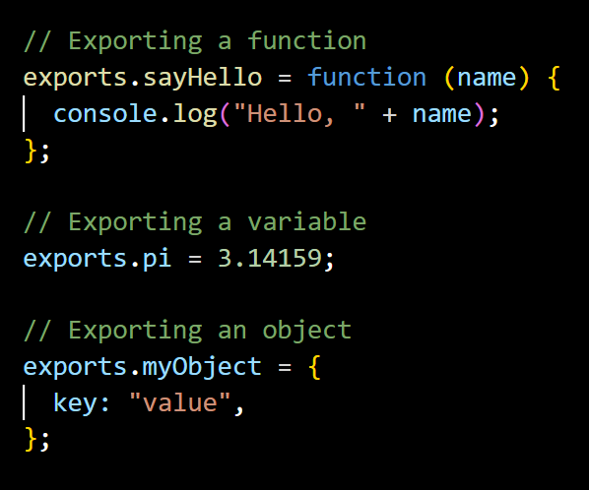
Q. How many ways are there to Export a module?
module.exports object can be used to export the module.
exports object can be also used directly to export the module.
Back to chapter index
Notes:
// Exporting a function
function sayHello(name) {
console.log("Hello, " + name);
}
// Exporting a variable
const pi = 3.14159;
// Exporting an object
const myObject = {
key: "value",
};
// Using module.exports
module.exports.sayHello = sayHello;
module.exports.pi = pi;
module.exports.myObject = myObject;
// myModule.js
// Exporting a function
exports.sayHello = function (name) {
console.log("Hello, " + name);
};
// Exporting a variable
exports.pi = 3.14159;
// Exporting an object
exports.myObject = {
key: "value",
};

Slide 27

Q. What will happen if you don’t export the module?
If you don’t export the module, then the module functions will not be available outside the module.
Back to chapter index

Slide 28
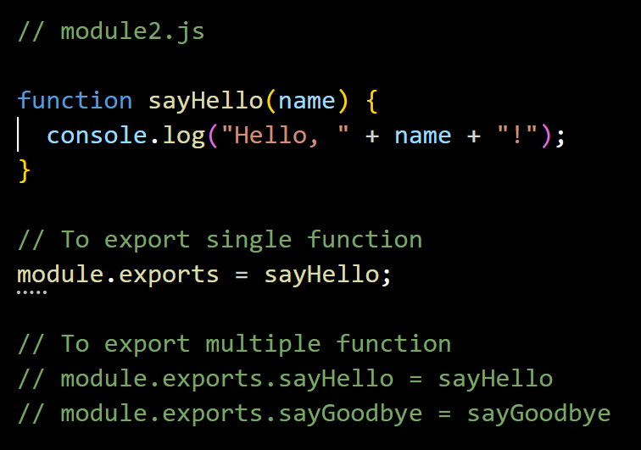
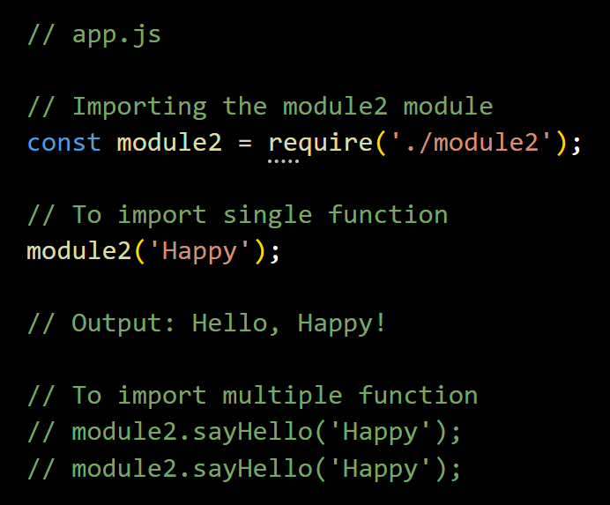
Q. How to import single and multiple functions from a module?
In Node.js, you can import a module using the require function.
Back to chapter index
Notes:
// app.js
// Importing the module2 module
const module2 = require('./module2');
// To import single function
module2('Happy');
// Output: Hello, Happy!
// To import multiple function
// module2.sayHello('Happy');
// module2.sayHello('Happy’);

Slide 29
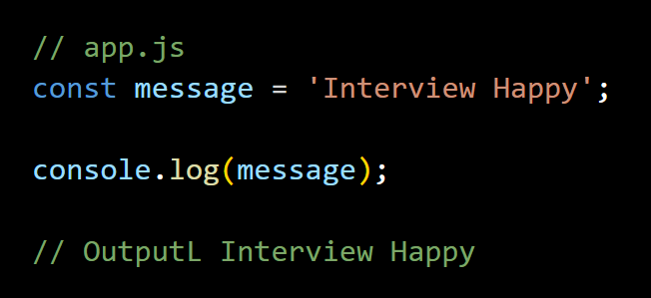
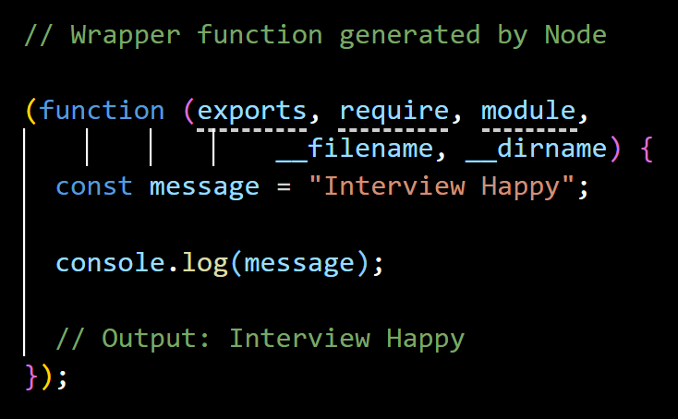
Q. What is module wrapper function?
In Node.js, each module is wrapped in a function called the "module wrapper function" before it is executed.
Converted/ wrapped by Node
Back to chapter index

Slide 30



Q. What are the Types of modules in Node?
1. Built-in Module
(Core Modules)
These are already present modules in Node.js which provide essential functionalities.
For example, fs (file system), http (HTTP server), path (path manipulation), and util (utilities).
2. Local Modules
These user-defined modules(JS files) created by developers for specific functionalities.
3. Third-Party Modules
These are external packages or libraries created by the community and provide additional functionalities for Node projects. You install third-party modules using the npm install command.
For example, npm install lodash.
Back to chapter index

Slide 31
4. Top built in modules
Q. What are the Top 5 built in modules commonly used in node projects?
Q. Explain the role of fs module? Name some functions of it?
Q. Explain the role of path module? Name some functions of it?
Q. Explain the role of OS module? Name some functions of it?
Q. Explain the role of events module? How to handle events in Node?
Q. What are Event Arguments?
Q. What is the difference between a function and an event?
Q. What is the role of http module in node?
Q. What is the role createServer() method of http module?
Back to main index

Slide 32
Q. What are the Top 5 built in modules commonly used in node projects?
Top 5 Built in Modules
1. fs
2. path
3. os
5. http
4. events
Back to chapter index

Slide 33
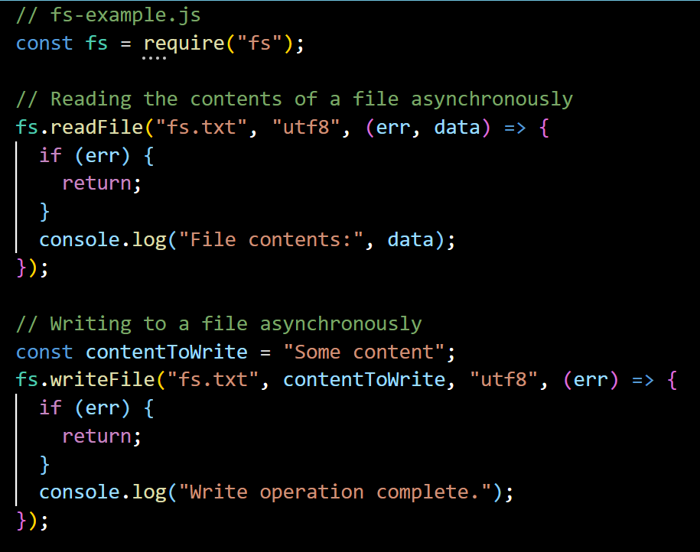
Q. Explain the role of fs module? Name some functions of it?
fs (File System) module in Node provides a set of methods for interacting with the file system.
Back to chapter index

Slide 34
Q. Explain the role of fs module? Name some functions of it?
7 Main functions of fs module:
1. fs.readFile()
Reads the content of the file specified
2. fs.writeFile()
Writes data to the specified file, creating the file if it does not exist.
3. fs.appendFile()
Appends data to a file. If the file does not exist, it is created.
4. fs.unlink()
Deletes the specified file.
5. fs.readdir()
Reads the contents of a directory.
6. fs.mkdir()
Creates a new directory.
7. fs.rmdir()
Removes the specified directory.
Back to chapter index

Slide 35
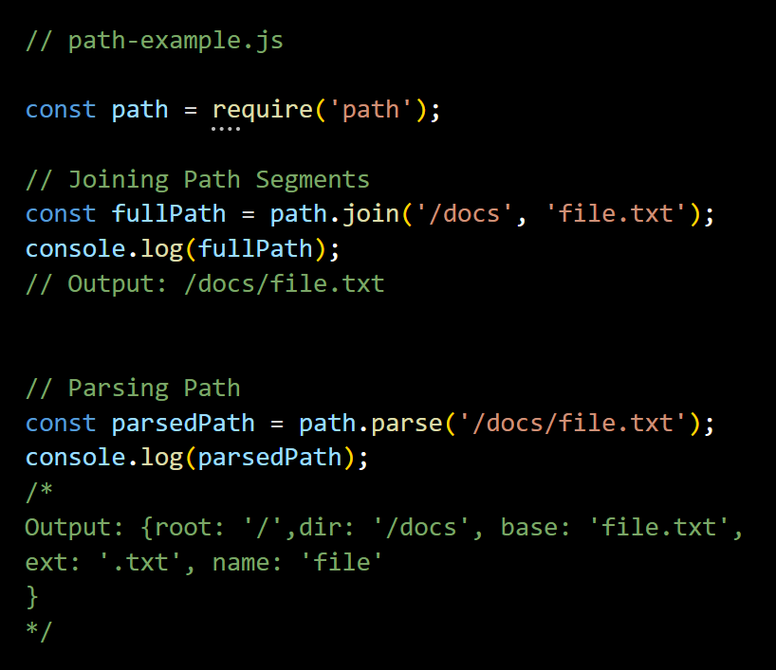
Q. Explain the role of path module? Name some functions of it?
Path module provides utilities for joining, resolving, parsing, formatting, normalizing, and manipulating paths.
Back to chapter index

Slide 36
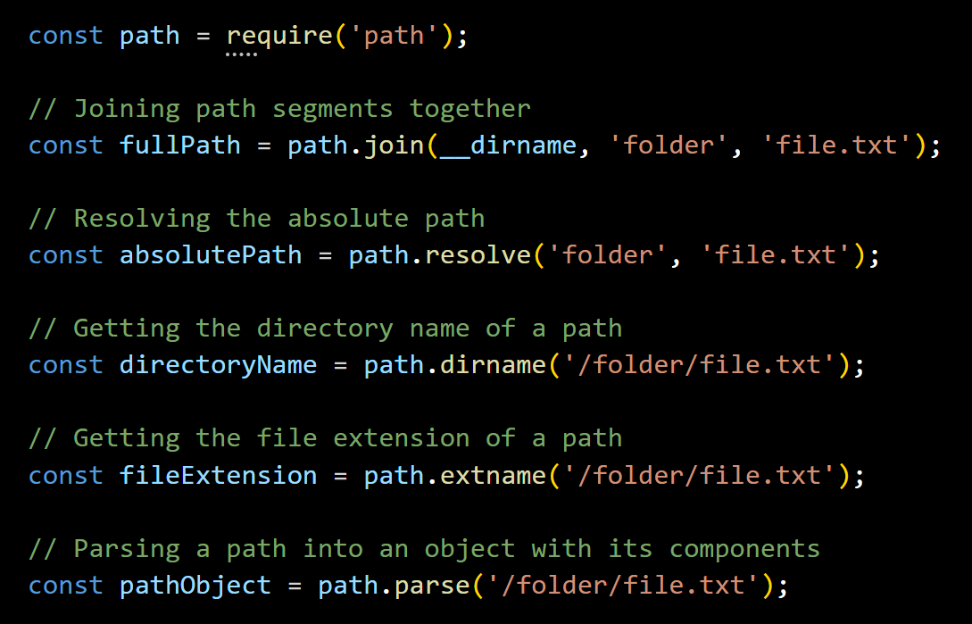
Q. Explain the role of path module? Name some functions of it?
5 Main functions of path module:
Back to chapter index

Slide 37
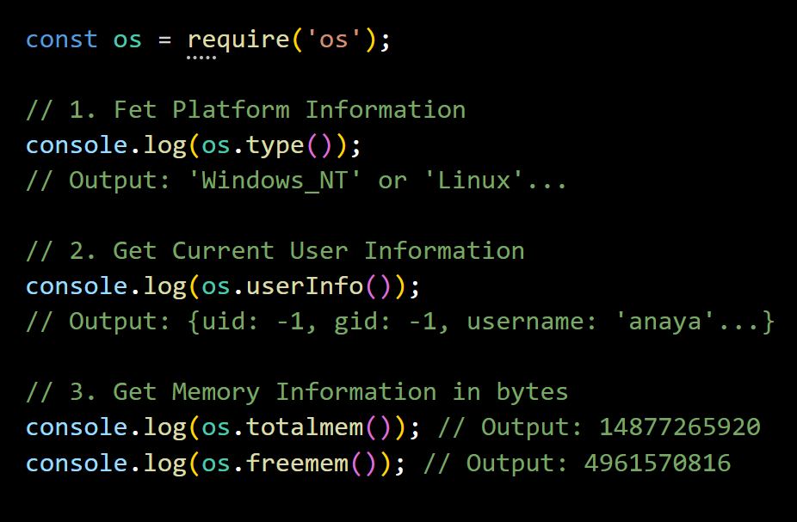
Q. Explain the role of OS module? Name some functions of it?
The os module in Node.js provides a set of methods for interacting with the operating system.
Operation system can be used by developers for building cross-platform applications or performing system-related tasks in Node.js applications.
Back to chapter index

Slide 38
Q. Explain the role of events module? How to handle events in Node?
Event: Signals that something has happened in a program.
Event Emitter: Create or emit events.
Event Queue: Events emitted queued(stored) in event queue.
Event Handler(Event Listener): Function that responds to specific events
Event Loop: The event loop picks up event from the event queue and executes them in the order they were added.
Event Driven Architecture: It means operations in Node are drive or based by events.
Event Emitters
Events Queue
Event Handler
E2
E1
Event Loop
Code
Back to chapter index

Slide 39
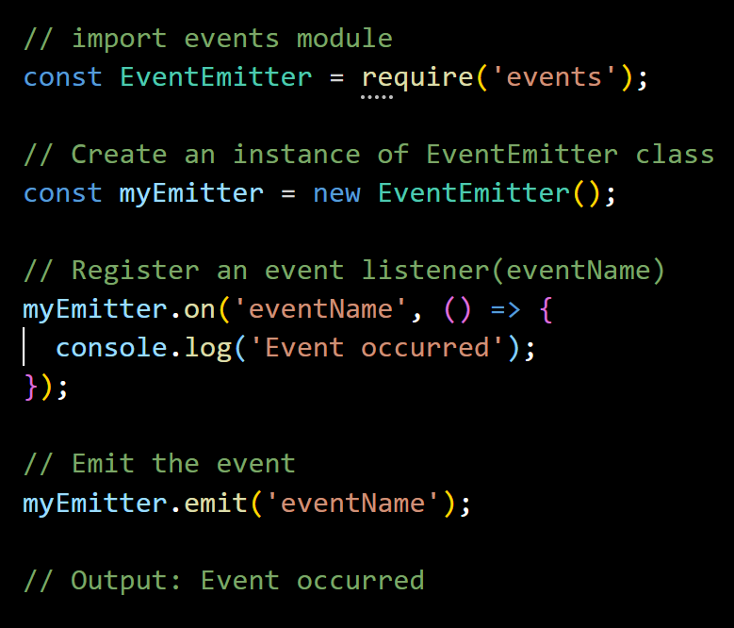
Q. Explain the role of events module? How to handle events in Node?
events module is used to handle events.
EventEmitter class of events module is used to register event listeners and emit events.
An event listener is a function that will be executed when a particular event occurs.
on() method is used to register event listeners.
Back to chapter index

Slide 40
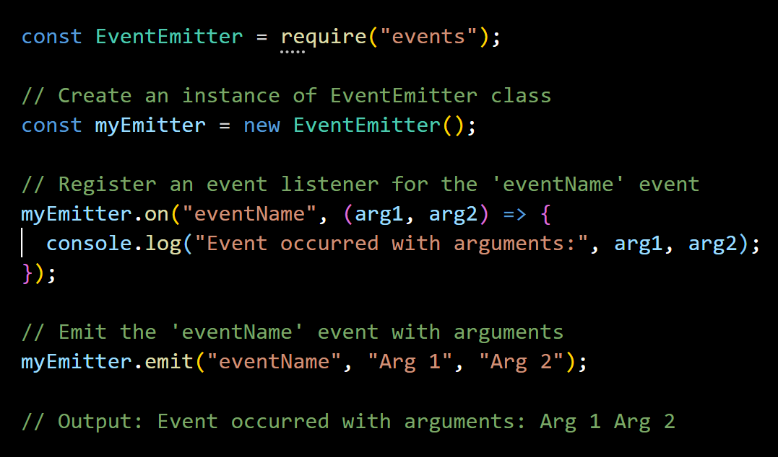
Q. What are Event Arguments?
event arguments refer to the additional information or data that can be passed along with an emitted event.
Back to chapter index

Slide 41
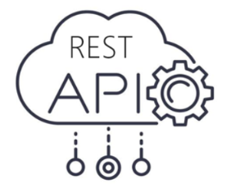
Q. What is the difference between a function and an event?
A function is a reusable piece of code that performs a specific task when invoked or called.
Events represent actions that can be observed and responded to. Events will call functions internally.
Request Received, Event Created
HTTP Request
HTTP Response
UI Server
API Server
Back to chapter index

Slide 42
Q. What is the role of http module in node?
The HTTP module can create an HTTP server that listens to server ports and gives a response back to the client.
UI Server
www.ui.example.com
API Server
www.api.example.com
(Hosted by http module only)
HTTP Request
www.ui.example.com
HTTP Request
www.api.example.com
HTTP Response
HTTP Response
Back to chapter index

Slide 43
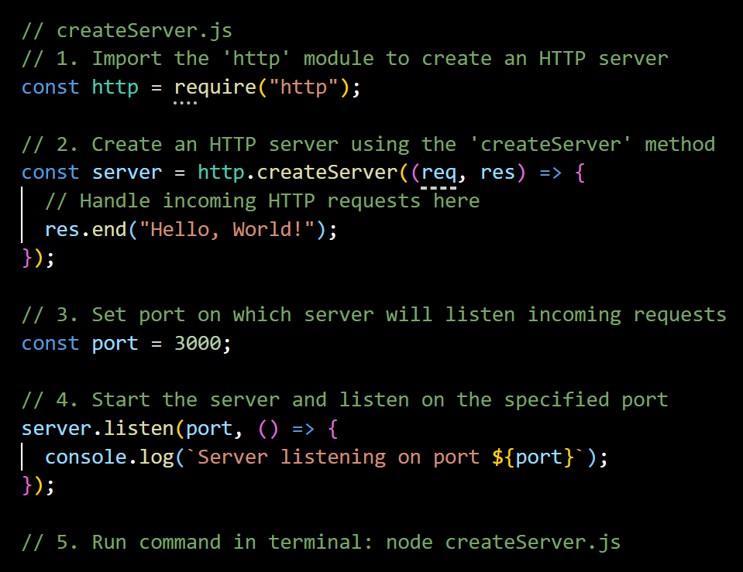
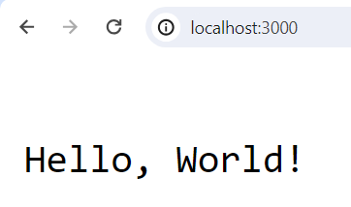
Q. What is the role createServer() method of http module?
The createServer() method of the http module in Node.js is used to create an HTTP server.
Back to chapter index

Slide 44
Chapters
FUNDAMENTALS
Node.js Basics
EXPRESS
REST API
REST API Basics
Main Features of Node.js
Project setup & Modules
Top built in modules
Express Basics
Middleware
Types of Middleware's
Routing - I
Routing - II
Template Engines
HTTP Methods & Status Codes
CORS, Serialization, Deserialization, Others
Authentication & Authorization
NODE - OTHERS
15 Error Handling & Debugging
MONGO-DB
23. Application based questions.
18. MongoDB Basics
Security, Performance & Deployment
Testing & Web Socket
Setup & CRUD operations
Query Operators & Projection
Indexes
Mongoose
JavaScript Essentials for Node
Scenario based short questions

Slide 45
5. Express - Basics
Q. What are the advantages of using Express.js with Node.js?
Q. How do you install Express.js in a Node.js project?
Q. How to create an HTTP Sever using Express.js?
Q. How do you create and start Express.js application?
Back to main index

Slide 46
Q. What are the advantages of using Express.js with Node.js?
1. Simplified Web Development
Express.js provides a lightweight framework that simplifies the process of building web applications in Node.js.
2. Middleware Support
Easy integration of middleware functions into application's request-response cycle.
3. Flexible Routing System
Defining routes for handling different HTTP methods (GET, POST, PUT, DELETE, etc.) and URL patterns is easy.
4. Template Engine Integration
Express.js supports various template engines making it easy to generate dynamic HTML content on the server side.
Back to chapter index

Slide 47
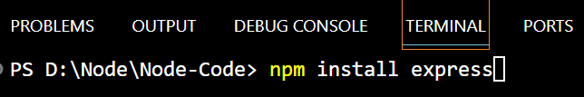
Q. How do you install Express.js in a Node.js project?
Run this command in terminal: npm install express
Back to chapter index

Slide 48
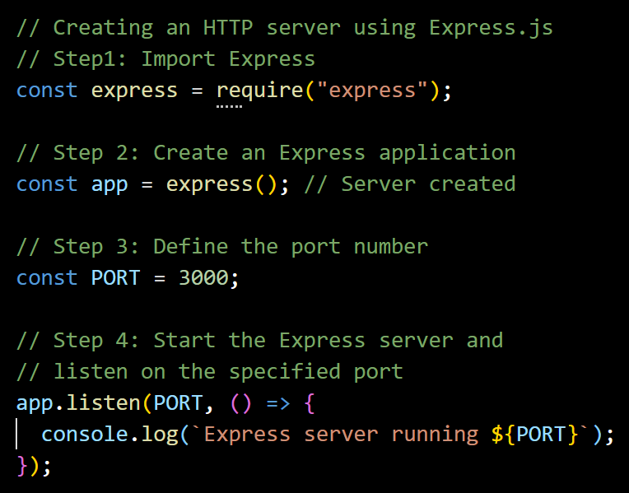
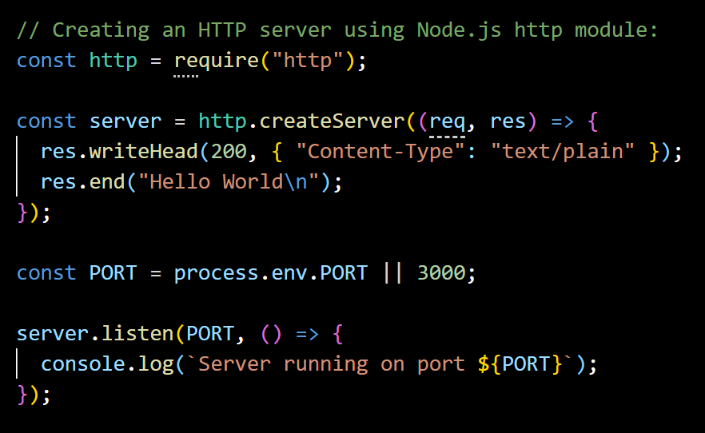
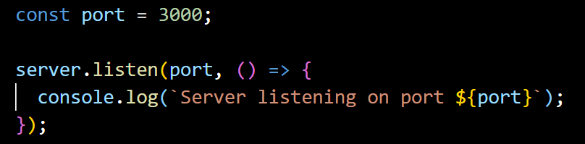
Q. How to create an HTTP Sever using Express.js?
Creating an HTTP Server using Express.js:
Creating an HTTP Server using Node.js http module:
Back to chapter index

Slide 49
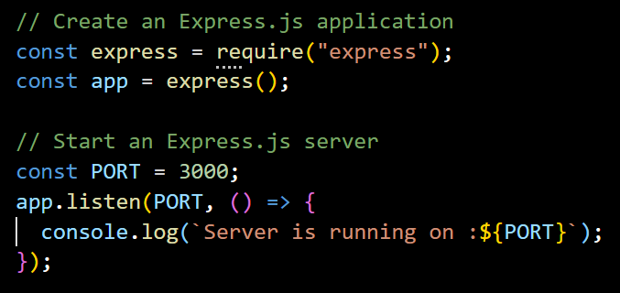
Q. How do you create and start Express.js application?
Create an Express.js application by requiring the express module and calling the express() function.
Start an Express.js server by calling the listen() method on the application object (app) and specifying the port number
Back to chapter index

Slide 50
6. Express - Middleware
Q. What is Middleware in Express.js and when to use them?
Q. How do you implement middleware in Express.js?
Q. What is the purpose of the app.use() function in Express.js?
Q. What is the purpose of the next parameter in Express.js?
Q. How to use middleware globally for a specific route?
Q. What is Request Pipeline in Express?
Back to main index

Slide 51
Q. What is Middleware in Express.js and when to use them?
A middleware in Express.js is a function that handles HTTP requests, performs operations, and passes control to the next middleware.
Frontend
Request Pipeline
HTTP Request
Application
Endpoints
(Get/ Post/ Put/Delete..)
Middleware 1
(Request Logging)
next()
Middleware 2
(Authentication)
next()
Middleware 3
(CORS)
HTTP Response
Back to chapter index

Slide 52
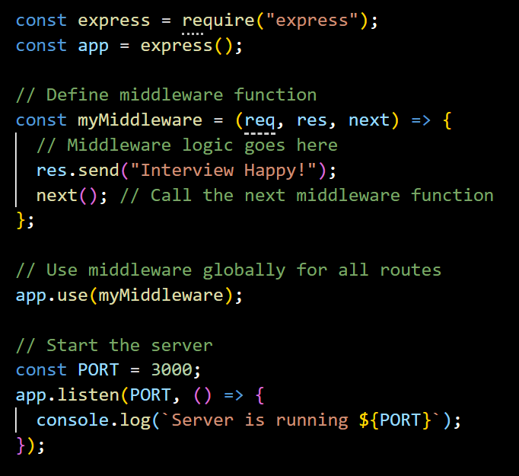
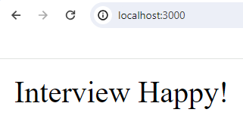
Q. How do you implement middleware in Express.js?
4 steps to use middleware:
Initialize an Express application.
Define a middleware function myMiddleware.
Use app.use() to mount myMiddleware globally, meaning it will be executed for every incoming request to the application.
Finally, we start the server by listening on a specified port (defaulting to port 3000) using app.listen().
Back to chapter index

Slide 53
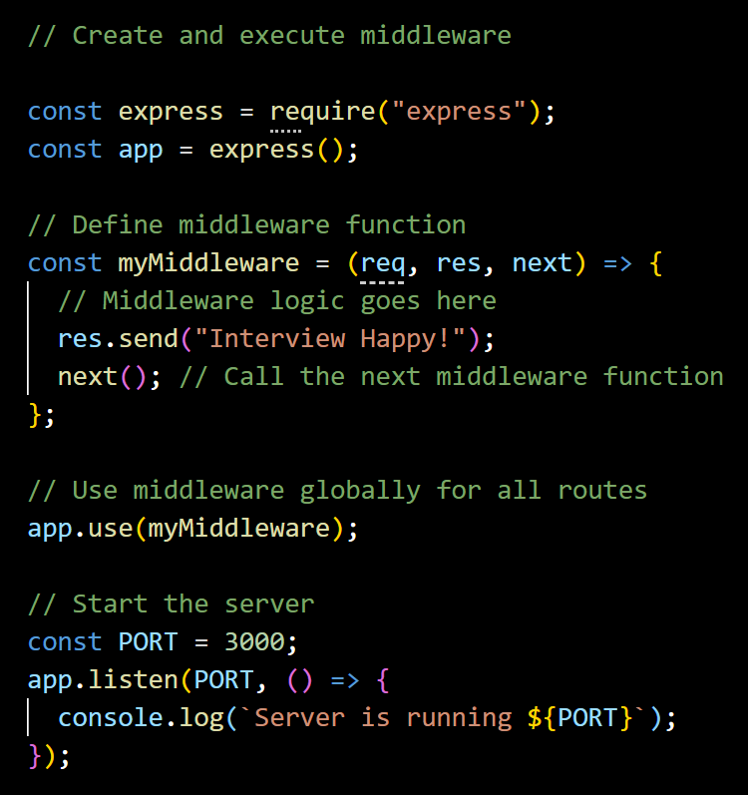
Q. What is the purpose of the app.use() function in Express.js?
The app.use() method is used to execute(mount) middleware functions globally.
Back to chapter index

Slide 54
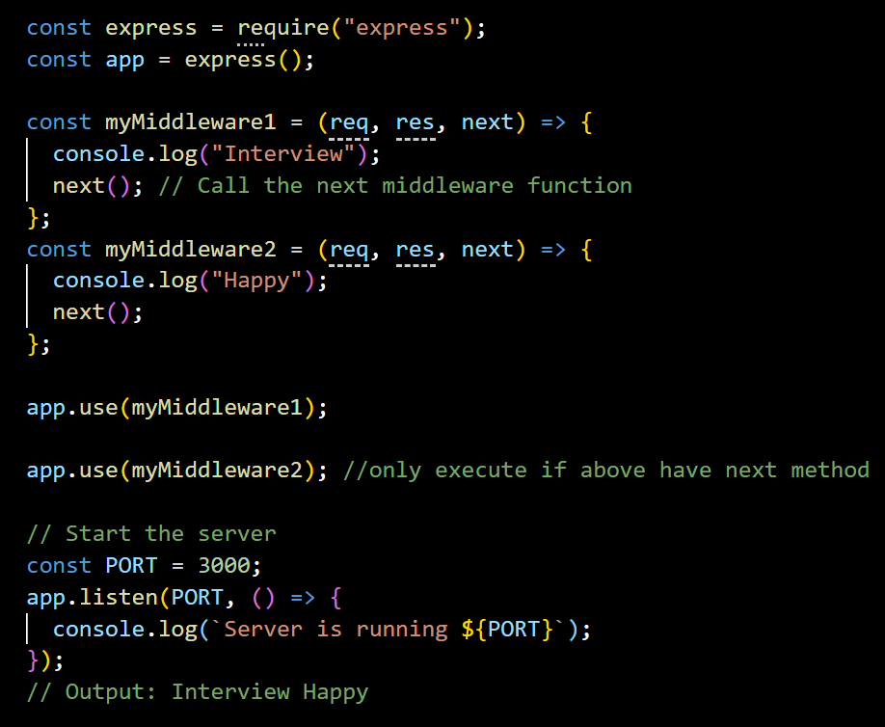
Q. What is the purpose of the next parameter in Express.js?
The next parameter is a callback function which is used to pass control to the next middleware function in the stack.
Back to chapter index

Slide 55
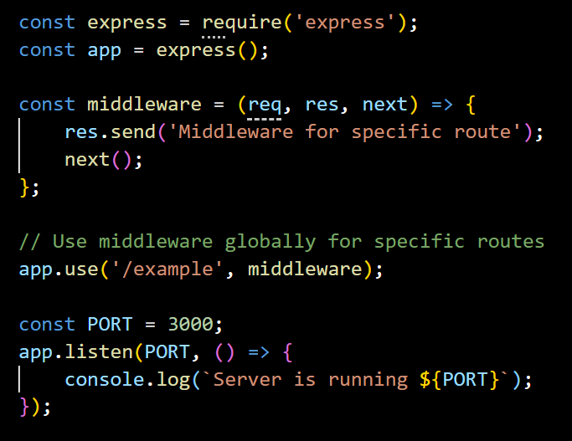
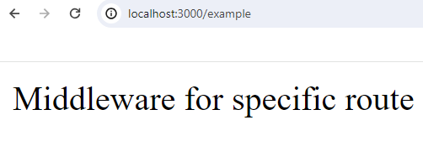
Q. How to use middleware globally for a specific route?
Use app.use('/specificRoute', myMiddleware) to use middleware globally for a specific route in Express.js
Back to chapter index

Slide 56
Q. What is Request Pipeline in Express?
The request pipeline in Express.js is a series of middleware functions that handle incoming HTTP requests and pass control to the next function.
Frontend
Request Pipeline
HTTP Request
Application
Endpoints
(Get/ Post/ Put/Delete..)
Middleware 1
(Request Logging)
next()
Middleware 2
(Authentication)
next()
Middleware 3
(CORS)
HTTP Response
Back to chapter index

Slide 57
7. Express - Types of Middleware's
Q. What are the type of middleware's in Express.js?
Q. What is the difference btw application-level & route-level middleware?
Q. What is error handling middleware and how to implement it?
Q. If you have 5 middlewares then in which middleware you will do the error handling?
Q. What is built in middleware? How to serve static files from Express.js?
Q. What are third-party middleware's? Give some examples?
Q. Can you summarize all the type of middleware's?
Q. What are the advantages of using middleware in Express.js?
Back to main index

Slide 58
Q. What are the Types of middleware's in Express.js?
5 Types of Middlewares
1. Application-level middleware
2. Router-level middleware
4. Built-in middleware
5. Third-party middleware
3. Error-handling middleware
Back to chapter index

Slide 59
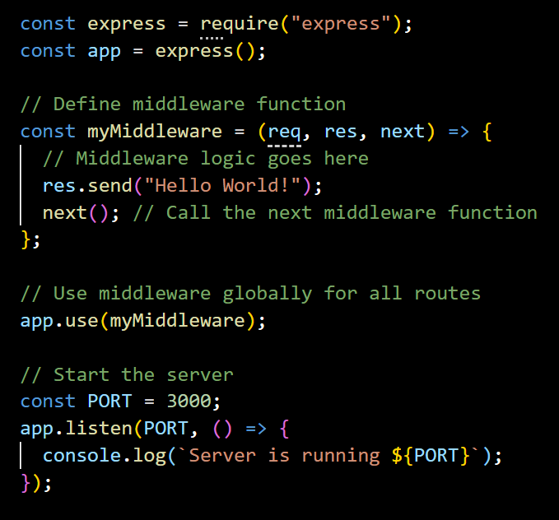
Q. What is the difference btw application-level & route-level middleware?
Application-level middleware applies globally to all incoming requests in the entire Express.js application.
Route-level middleware applies only to specific routes, not for all incoming requests.
Back to chapter index

Slide 60
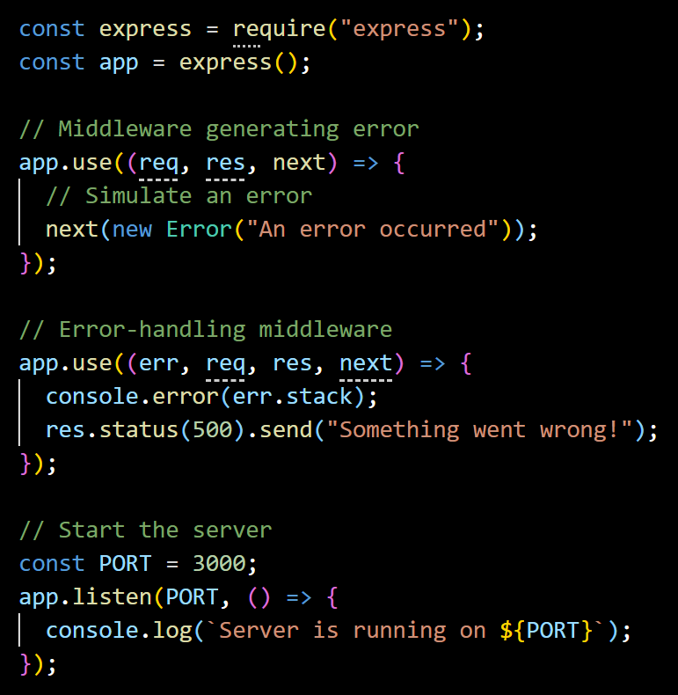
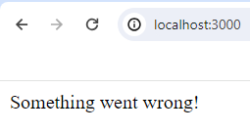

Q. What is error handling middleware and how to implement it?
Error handling middleware in Express is a special kind of middleware used to manage errors happening while handling incoming requests.
To implement error handling in Express, define middleware with four parameters (err, req, res, next). Here the additional error object parameter will be used for error handling.
Back to chapter index

Slide 61
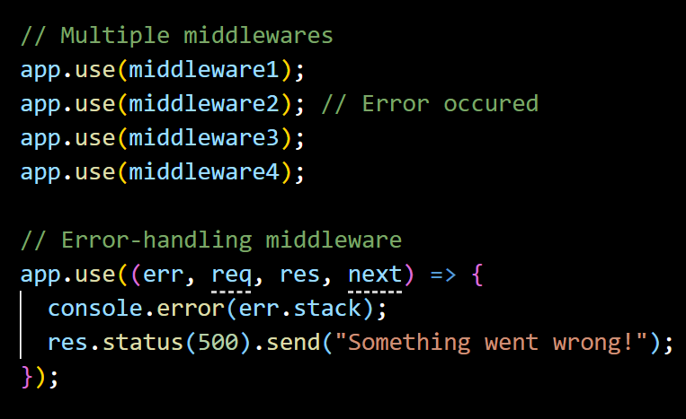
Q. If you have 5 middlewares then in which middleware you will do the error handling?
In case of multiple middleware, error-handling middleware should be defined at last(after all other middleware’s) because when an error occurs, Express.js will search for the next error-handling middleware skipping any regular middleware or route handlers.
Back to chapter index

Slide 62
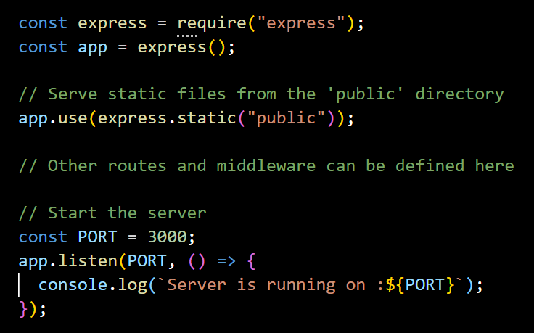
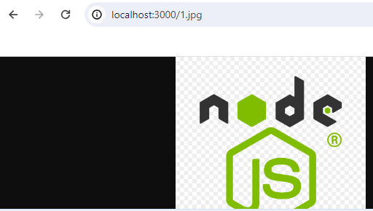
Q. What is built in middleware? How to serve static files from Express.js?
Built in middleware’s are built in functions inside Express framework which provides common functionalities.
express.static() middleware is used for serving static files.
Back to chapter index

Slide 63
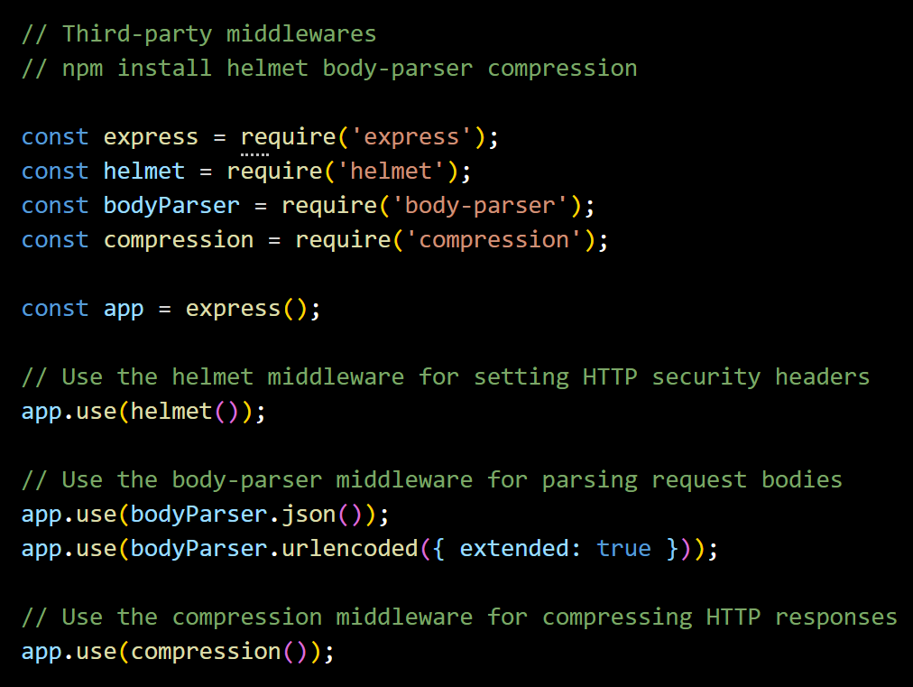
Q. What are third-party middleware's? Give some examples?
Third-party middleware in Express.js are modules developed by third-party developers(not part of the core Express.js).
Third-party middleware’s provide functionalities like logging, security, body parsing, and compression.
Example of third-party middleware’s: morgan, helmet, body-parser, compression etc.
Back to chapter index

Slide 64
Q. Can you summarize all the type of middleware's?
1. Application-level middleware
2. Router-level middleware
4. Error-handling middleware
5. Third-party middleware
3. Built-in middleware
Middleware applied to all routes; commonly used for logging, authentication, etc.
Middleware specific to certain routes; applied using or .
Pre-packaged middleware included with Express.js, like for serving static files.
Middleware for handling errors; declared after other middleware, triggered on errors.
Middleware developed by others, not part of Express.js core; adds various functionalities.
Back to chapter index

Slide 65
Q. What are the advantages of using middleware in Express.js?
1. Modularity
Middleware allows you to modularize your application's functionality into smaller, self-contained units. Each middleware function can handle a specific task or concern, such as logging, authentication, or error handling.
2. Reusability
Middlewares can be reused at multiple places and that makes application code easier to maintain.
3. Improved Request Handling
Middleware functions have access to both the request (req) and response (res) objects which enables you to perform validations on request or modify the response before sending it back to the client.
4. Flexible Control Flow
Middleware functions can be applied globally to all routes or selectively to specific routes, allowing you to control the flow of request processing in your application.
5. Third-party Middleware’s
Express.js offers a wide range of third-party middleware packages that provide additional functionality. For eg: body-parser, cors etc.
Back to chapter index

Slide 66
8. Express - Routing - I
Q. What is Routing in Express.js?
Q. What is the difference between middleware & routing in Express?
Q. How to implement routing? How do you define routes in Express.js?
Q. How to handle Routing in Express.js real applications?
Q. What are Route Handlers?
Q. What are Route Parameters in Express.js?
Back to main index

Slide 67
Q. What is Routing in Express.js?
Routing is the process of directing incoming HTTP requests to the appropriate handler functions based on the request's method (e.g., GET, POST) and the URL path.
Frontend
Controllers
Orders: Get()
/orders:orderId
HTTP Request
Middlewares
Routing
/products
Products: Get()
/payments
Payments: Get()
HTTP Response
Back to chapter index

Slide 68
Q. What is the difference between middleware & routing in Express?
Middleware | Routing
1. Middleware are functions. | 1. Routing is a process.
2. Middleware functions can access and the request and response objects, then they can: perform some actions(logic like authorization) End the request-response cycle Call the next middleware function. | Routing is the process of directing incoming HTTP requests to the appropriate handler functions(Get, Put, Post/ Delete).
Back to chapter index

Slide 69
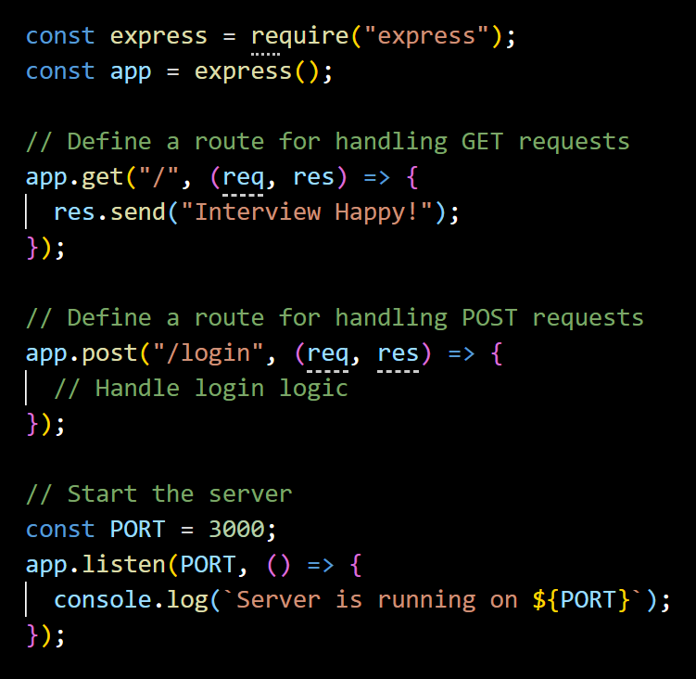
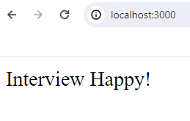
Q. How to implement routing? How do you define routes in Express.js?
To implement routing first define the routes.
In Express.js, routes are defined using the app.METHOD() functions. (where METHOD is the HTTP request method (e.g., GET, POST, PUT, DELETE) and app is an instance of the Express application).
Back to chapter index

Slide 70

Q. How to handle Routing in Express.js real applications?
5 steps for setup routing:
1. Import Express
2. Set Middleware's
3. Import Controllers
4. Define Routes for different endpoints
5. Start the server
Back to chapter index

Slide 71
Q. What are Route Handlers?
Route handler is the second argument passed to app.get() or app.post().
route handler function is used to process the request and generate a response.
Back to chapter index

Slide 72

Q. What are Route Parameters in Express.js?
Route parameters in Express.js allow you to capture dynamic values from the URL paths.
Route parameters can be accessed by using req.params object.
Back to chapter index

Slide 73
9. Express - Routing - II
Q. What are Router object & Router Methods and how to implement them?
Q. What are the types of Router Methods?
Q. What is the difference between app.get() and router.get() method?
Q. What is express.Router() in Express.js?
Q. Share a real application use of Routing?
Q. What is Route Chaining in Express.js?
Q. What is Route Nesting in Express.js?
Q. How to implement route nesting in Express.js?

Slide 74



Q. What are Router object & Router Methods and how to implement them?
The router object is a mini version of an Express application which is used for handling routes.
Router Methods are functions provided by the Router object to define routes for different HTTP methods (GET, POST, DELETE, etc.).
Implement router method
Use router method
Back to chapter index

Slide 75
Q. What are the types of Router Methods?
Router methods
router.get(path, callback)
router.post(path, callback)
router.put(path, callback)
router.delete(path, callback)
Back to chapter index

Slide 76


Q. What is the difference between app.get() and router.get() method?
The app.get() method is used to define routes directly on the application object.
Routes defined using app.get() are automatically mounted on the root path (/).
Routes defined using app.get() are not modular and cannot be reused in other applications.
The router.get() method is used to define routes on a router object.
Routes defined using router.get() are not automatically mounted; they must be explicitly mounted using app.use().
Routes defined using router.get() are modular and can be reused in other applications by exporting the router object.
Back to chapter index

Slide 77

Q. What is express.Router() in Express.js?
express.Router is a class in Express.js that returns a new router object.
Back to chapter index

Slide 78


Q. Share a real application use of Routing?
Routing is used for authenticating requests based on the token available in request header.
Back to chapter index

Slide 79


Q. What is Route Chaining in Express.js?
Route chaining is a process defining multiple route handlers for a single route.
This pattern helps in modularity, organizing code, improving readability, and separating concerns.
Back to chapter index

Slide 80
Q. What is Route Nesting in Express.js?
Route nesting organize routes hierarchically by grouping related routes under a common URL prefix.
Advantage: This allows you to create more modular and structured routes, making your codebase easier to manage and maintain.
www.example.com
/users
/profile
/products
/features
/ratings
Route 1
www.example.com/users
www.example.com/users/profile
Route 2
www.example.com/products
www.example.com/products/features
www.example.com/products/ratings
Back to chapter index

Slide 81



Q. How to implement route nesting in Express.js?
Back to chapter index

Slide 82
10. Express - Template Engines
Q. What are Template Engines in Express.js?
Q. Name some Template Engines libraries?
Q. How to implement EJS templating engine in a Express.js application?
Back to main index

Slide 83




Q. What are Template Engines in Express.js?
Template engines are libraries that enable developers to generate dynamic HTML content by combining static HTML templates with data.
Data
Template Engine
HTML Document
Static HTML Template
Back to chapter index

Slide 84
Q. Name some Template Engines libraries?
Template Engines
1. EJS(Embedded JavaScript)
2. Handlebars
3. Pug (formerly Jade)
4. Mustache
5. Nunjucks
Back to chapter index

Slide 85





Q. How to implement EJS templating engine in a Express.js application?
Back to chapter index

Slide 86
Q. How to implement EJS templating engine in a Express.js application?
3. Create server file and set the view engine to EJS .
4. Specify the views directory.
5. Render EJS templates using res.render() method.
1. Install EJS: npm install ejs.
2. Create html template file index.ejs.
Back to chapter index

Slide 87
Chapters
FUNDAMENTALS
Node.js Basics
EXPRESS
REST API
REST API Basics
Main Features of Node.js
Project setup & Modules
Top built in modules
Express Basics
Middleware
Types of Middleware's
Routing - I
Routing - II
Template Engines
HTTP Methods & Status Codes
CORS, Serialization, Deserialization, Others
Authentication & Authorization
NODE - OTHERS
15 Error Handling & Debugging
MONGO-DB
23. Application based questions.
18. MongoDB Basics
Security, Performance & Deployment
Testing & Web Socket
Setup & CRUD operations
Query Operators & Projection
Indexes
Mongoose
JavaScript Essentials for Node
Scenario based short questions

Slide 88
11. REST API - Basics
Q. What is REST & RESTful API?
Q. What are HTTP Request and Response structures in UI and REST API?
Q. What are Top 5 REST guidelines and the advantages of them?
Q. What is the difference between REST API and SOAP API?
Back to main index

Slide 89
Q. What is REST & RESTful API?
REST (Representational State Transfer) is an architectural style for designing networked applications (REST is a set of guidelines for creating API’s).
RESTful API is a service which follow REST principles/ guidelines.
Client-Side
Server-Side (REST API)
Database Server
Request
Request
Response
(html)
Response
(json)
Back to chapter index

Slide 90
Q. What are HTTP Request and Response structures in UI and REST API?
HTTP Action & URL
Type of Request
UI Server Address
Request Body
POST /user/submit-form
HTTP/1.1
Host: ui-server.example.com
uid=john&password=123
// Header, content-type…
POST /api/user/create
HTTP/1.1
Host: api-server.example.com
uid=john&password=123
// Header, content-type…
HTTP Request
HTTP Request
UI Server
HTTP Response
(HTML)
HTTP Response
(JSON)
HTTP/1.1 200 OK
Content-Type: text/html;
Content-Length: 158
<!DOCTYPE html>
<html></html>
HTTP/1.1 201 Created
Content-Type: application/json;
{
"userId": 123,
"message": "User created"
}
Back to chapter index

Slide 91
Q. What are HTTP Request and Response structures in UI and REST API?
HTTP Request
An HTTP (Hypertext Transfer Protocol) request is a message sent by a client (such as a web browser or a mobile app) to a server, requesting a particular action or resource.
It contains HTTP Action(GET, POST…), URL, Request Body, Request Header.
HTTP Response
An HTTP response is a message sent by a server back to the client in response to an HTTP request.
It includes status code, content type, content.
Back to chapter index

Slide 92
Q. What are Top 5 REST guidelines and the advantages of them?
REST guidelines
1. Separation of Client and Server
2. Stateless
3. Uniform interface
4. Cacheable
5. Layered system
Back to chapter index

Slide 93
Q. What are Top 5 REST guidelines and the advantages of them?
1. Separation of Client & Server
2. Stateless
The server will not store anything about the latest HTTP request the client made.
3. Uniform interface
Identify the resources by URL (e.g., www.abc.com/api/questions).
4. Cacheable
The API response should be cacheable to improve the performance.
5. Layered system
The system should follow layered pattern.
Advantage: Independence allows easier maintenance, scalability, and evolution.
Advantage: It will treat every request as new request. It simplifies server implementation as it is not overloading it with state management.
The implementation of the client and the server must be done independently.
Advantage: Caching API responses improves performance by reducing the need for repeated requests to the server.
Advantage: standardized URLs, making it easy to understand and use the API.
Advantage: A layered system, such as the Model-View-Controller (MVC) pattern, promotes modular design and separation of concerns.
Back to chapter index

Slide 94
Q. What is the difference between REST API and SOAP API?
Feature | REST API | SOAP API
Architecture | REST is an architectural style. | SOAP(Simple Object Access Protocol) is a protocol.
Protocol | Uses HTTP or HTTPS. | Can use various protocols (HTTP, SMTP, etc.).
Message Format | Uses lightweight formats like JSON, XML. | Typically uses XML.
State | Stateless. | Can be stateful or stateless.
Error Handling | Relies on HTTP status codes. | Defines its own fault mechanism.
Performance | Generally lightweight and faster. | Can be slower due to XML processing.
Back to chapter index

Slide 95
12. REST API - HTTP Methods & Status Codes
Q. What are HTTP Verbs and HTTP methods?
Q. What are GET, POST, PUT & DELETE HTTP methods?
Q. What is the difference between PUT & PATCH methods?
Q. Explain the concept of Idempotence in RESTful APIs.
Q. What are the role of status codes in RESTful APIs?
Back to main index

Slide 96
Q. What are HTTP Verbs and HTTP methods?
HTTP methods, also known as HTTP verbs, are a set of actions that a client can take on a resource.
GET
Request
POST
PUT
Response
DELETE
UI/ Client/ Frontend
PATCH
Database Server
Back to chapter index

Slide 97
Q. What are GET, POST, PUT & DELETE HTTP methods?
HTTP Method | Action | Example
GET | Retrieve data from a specified resource | www.example.com/users (retrieve users list) www.example.com/users/123 (retrieve single user of id - 123)
POST | Submit data to be processed | www.example.com/users (submit and create a new user from data provided in request)
PUT | Update a resource or create a new resource if it does not exist | www.example.com/users/123 (update user 123 details from data provided in request)
DELETE | Request removal of a resource | www.example.com/users/123 (delete user 123)
Back to chapter index

Slide 98


Q. What is the difference between PUT & PATCH methods?
PUT | PATCH
Both PUT and PATCH method are used to update a resource by replacing the resource with the new data provided in the request.
Full Resource Replacement: In a PUT request, the client sends the full updated resource in the request body, replacing the existing resource on the server. | Partial Updates: In a PATCH request, the client sends specific changes or instructions for modifying the resource, updating only certain fields without resending the entire resource.
Back to chapter index

Slide 99
Q. Explain the concept of Idempotence in RESTful APIs.
Idempotence meaning performing an operation multiple times should have the same outcome as performing it once. For example, Sending multiple identical GET requests will always return the same response
Performing same operation multiple times
(GET: www.abc.com/users )
Same output/ response/ result
Idempotent Methods
GET
PUT
Non-Idempotent Methods
POST
DELETE
Back to chapter index

Slide 100
Q. What are the role of status codes in RESTful APIs?
Status codes are used to convey the results of a client’s request.
2XX (Success)
200: OK
4XX (Client Error)
400: Bad Request
401 Unauthorized
5XX (Server Error)
500: Internal Server Error
501: Not Implemented
1XX (Info)
100 Continue
3XX (Redirection)
201: Created
202: Accepted
204: No Content
300: Multiple Choices
403 Forbidden
404 Not Found
502: Bad Gateway
503: Service Unavailable
Back to chapter index

Slide 101
13. REST API - CORS, Serialization, Deserialization, Others
Q. What is CORS in RESTful APIs?
Q. How to remove CORS restrictions RESTful APIs?
Q. What are Serialization & Deserialization?
Q. What are the types of serialization?
Q. How to Serialize & Deserialize in Node.js?
Q. Explain the concept of versioning in RESTful APIs.
Q. What is an API document? What are the popular documentation formats?
Q. What is the typical structure of a REST API project in Node?
Back to main index

Slide 102


Q. What is CORS in RESTful APIs?
CORS(Cross-Origin Resource Sharing) is a security feature implemented in web browsers that restricts web pages or scripts from making requests to a different domain than the one that served the web page.
http://interviewhappy.com/getdata
(same domain not restricted)
http://xyz.com/getdata
(different domain restricted)
http://interviewhappy.com/index.html
http://api.interviewhappy.com/getdata
(different sub-domain restricted)
https://interviewhappy.com/getdata
(different protocol restricted)
http://interviewhappy.com:12/getdata
(different port restricted)
Back to chapter index

Slide 103

Q. How to remove CORS restrictions RESTful APIs?
CORS restrictions can be removed by enabling CORS middleware in application.
Back to chapter index

Slide 104
Q. What are Serialization & Deserialization?
Serialization is the process of converting an object into a format that can be stored, transmitted, or reconstructed later.
Deserialization is the process of converting serialized data, such as binary/ XML/ json data, back into an object.
Serialization
Deserialization
REST API 1
REST API 2
Object
json
Sent over network(json)
json
Object
Back to chapter index

Slide 105
Q. What are the types of serialization?
Types of Serialization
Binary
Serialization
XML
Serialization
JSON
Serialization
Back to chapter index

Slide 106

Q. How to Serialize & Deserialize in Node.js?
Serialize a JavaScript object into JSON format using JSON.stringify().
Deserialize a JSON string into a JavaScript object using JSON.parse().
Back to chapter index

Slide 107
Q. Explain the concept of versioning in RESTful APIs.
Versioning in RESTful APIs refers to the practice of maintaining multiple versions of an API to support backward compatibility.
Client A
Version 1
Version 2
Client B
Version 3
Client C
https://api.example.com/v1/resource
https://api.example.com/v2/resource
https://api.example.com/v3/resource
Back to chapter index

Slide 108

Q. What is an API document? What are the popular documentation formats?
An API document, describe the functionality, features, and usage of a REST API.
REST API Documentation Formats
1. Swagger (OpenAPI)
2. RAML
3. API Blueprint
Back to chapter index

Slide 109
Q. What is the typical structure of a REST API project in Node?
node_modules: Directory where npm packages are installed.
src: Source code directory.
  controllers: Contains files responsible for handling business logic.
  models: Defines data models.
  routes: Defines API routes.
  utils: Contains reusable functions used across the project.
  app.js: Initializes and configures the Express application. Connects routes, middleware, and other configurations.
.gitignore: A file that specifies files and directories to be ignored by version control (e.g., node_modules, *.log).
package.json: The file that contains metadata about the project and its dependencies.
/ecommerce-project-root
|-- node_modules
|-- src
| |-- controllers
| | |-- productController.js
| | |-- userController.js
| |-- models
| | |-- productModel.js
| | |-- userModel.js
| |-- routes
| | |-- productRoutes.js
| | |-- userRoutes.js
| |-- utils
| | |-- errorHandlers.js
| | |-- validators.js
| |-- app.js
|-- .gitignore
|-- package.json
Back to chapter index

Slide 110
14. REST API - Authentication & Authorization
Q. What are Authentication and Authorization?
Q. What are the types of authentication in Node.js?
Q. What is Basic Authentication?
Q. What are the security risks associated with storing passwords in plain text in Node.js?
Q. What is the role of Hashing and Salt in securing passwords?
Q. How can we securely hash passwords in Node.js?
Q. What is API Key Authentication?
Q. What is Token based and JWT authentication?
Q. What are the parts of JWT token?
Q. Where JWT token reside in the request?
Back to main index

Slide 111




Q. What are Authentication and Authorization?
Authentication is the process of verifying the identity of a user by validating their credentials such as username and password.
Authorization is the process of allowing an authenticated user access to resources. Authentication is always precedes to Authorization.
www.school.com
www.school.com/student/happy
Menu | View Result | Edit Result | Fees | Salary
USERNAME
Happy
PASSWORD
*********
(only teachers have rights)
(only teachers have rights)
SIGNIN
Authentication(Who are you?)
Authorization(Your rights/ access?)
Back to chapter index

Slide 112
Q. What are the types of authentication in Node.js?
5 Types of Authentication
1. Basic (Username and Password) Authentication
2. API Key Authentication
3. Token-based Authentication (JWT)
4. Multi-factor Authentication (MFA)
5. Certificate-based Authentication
Back to chapter index

Slide 113
Q. What is Basic Authentication?
In Basic Authentication, the user passes their credentials on a post request. At the Node Rest API end, credentials are verified, and response is sent back.
www.school.com
USERNAME
Happy
The disadvantage of it is, Basic Authentication sends credentials in plain text over the network, so it is not considered a secure method of authentication.
PASSWORD
*********
SIGNIN
Authentication(Who are you?)
Back to chapter index

Slide 114
Q. What are the security risks associated with storing passwords in plain text in Node.js?
Unauthorized Access: Storing passwords in plain text means that anyone with access to the storage location, such as a database or configuration file, can easily read and extract passwords.
Compromise of Other Accounts: Many users tend to reuse passwords across multiple accounts, allowing attackers to access to multiple accounts.
UserId | UserName | Password
11111 | lallu123456 | test
22222 | tallu123456 | password
33333 | ballu123456 | talli
UserId | UserName | Password
11111 | 12313kjiik?df | 3434jkjkjffaf
22222 | sdfkasjs33444 | asdfasfk444
33333 | dsfkjaskfj333 | asfasii33333
Encode
Stored as Plain Text (Less secure)
Stored in Encrypted format (More secure)
Back to chapter index

Slide 115
Q. What is the role of Hashing and Salt in securing passwords?
Hashing: Hashing is a process of converting a password into a fixed-size string of characters using a mathematical algorithm.
Salt: A salt is a random string of data combined with a password before hashing.
  Salting ensures security even if the hacker knows the hashing algorithm.
  Salting ensures that even if two users have the same password, their hashed passwords will be different due to the unique salt. Typically, each user has unique salt.
Generate Salt by using bcrypt library
(random sting)
Plain Text Password
$2b$10$zZK9Kq3ZZ9Zd8E4w83jLk
password123
Hashing
(using algorithm)
7SipLzFeuQQNbWlQXXX
$2b$10$zZK9Kq3ZZ9Zd8E4w83jLk.7SipLzFeuQQNbWlQXXX
Salt
Hash
Secure Password
Back to chapter index

Slide 116

Q. How can we create hash passwords in Node.js?
1
Generate a random salt
2
Create a hash object using SHA-256
3
Update the hash object with the salt and password
4
Get the hashed data in a hexadecimal string
5
Return the salt and hashed password as a string
Back to chapter index

Slide 117

Q. What is API Key Authentication?
API Key Authentication - In API Key Authentication, the API owner will share an API key with the users and this key will authenticate the users of that API.
The disadvantage of it is, API keys can be shared or stolen therefore it may not be suitable for all scenarios.
Back to chapter index

Slide 118



Q. What is Token based and JWT authentication?
Front-end/ Client-side
RES API
1. POST: {username, password}
2. Authenticate &
create JWT Token
3. Return Response {JWT token}
4. Store JWT token at local storage
5. Request Data {JWT token: Header}
6. Validate token signature
8. Display data on browser
7. Send Data
Back to chapter index

Slide 119

Q. What are the parts of JWT token?
JWT token has 3 parts:
Header
Payload
Signature
Algorithm used to generate the token.
JWT Token
The type of the token, which is JWT here.
The payload contains the CLAIMS.
The signature is a string that is used to ensure the INTEGRITY of the token and verify that it has not been tampered with.
Back to chapter index

Slide 120

Q. Where JWT token reside in the request?
In REQUEST HEADER.
Back to chapter index

Slide 121
Chapters
FUNDAMENTALS
Node.js Basics
EXPRESS
REST API
REST API Basics
Main Features of Node.js
Project setup & Modules
Top built in modules
Express Basics
Middleware
Types of Middleware's
Routing - I
Routing - II
Template Engines
HTTP Methods & Status Codes
CORS, Serialization, Deserialization, Others
Authentication & Authorization
NODE - OTHERS
15 Error Handling & Debugging
MONGO-DB
23. Application based questions.
18. MongoDB Basics
Security, Performance & Deployment
Testing & Web Socket
Setup & CRUD operations
Query Operators & Projection
Indexes
Mongoose
JavaScript Essentials for Node
Scenario based short questions

Slide 122
15. Error Handling & Debugging
Q. What is Error Handling? In how many ways you can do error handling in Node.js?
Q. How to handle errors in synchronous operations using try-catch-finally?
Q. What is Error-First Callbacks?
Q. How to handle errors using Promises?
Q. How to handle errors while using async-await?
Q. How can you Debug Node.js applications?
Back to main index

Slide 123
Q. What is Error Handling? In how many ways you can do error handling in Node.js?
4 ways to implement error handling in Node.js
1. Try-Catch (Sync)
2. Error-First Callbacks (Async)
3. Promises (Async)
4. Try-Catch with async-await (Async)
Error handling is the process of managing errors that occur during the execution of a program or system.
Back to chapter index

Slide 124

Q. How to handle errors in synchronous operations using try-catch-finally?
TRY − A try block is a block of code inside which any error can occur.
CATCH − When any error occur in TRY block then it is passed to catch block to handle it.
FINALLY − The finally block is used to execute a given set of statements, whether an exception occur or not.
Back to chapter index

Slide 125

Q. What is Error-First Callbacks?
Error-First Callbacks is a convention in Node.js for handling asynchronous operations.
They are called Error-First Callbacks because the first argument of a callback function is reserved for an error object.
Back to chapter index

Slide 126

Q. How to handle errors using Promises?
.catch() method is used in Promises for error handling.
Back to chapter index

Slide 127

Q. How to handle errors while using async-await?
try-catch block is used with async-await for handling errors.
Back to chapter index

Slide 128
Q. How can you Debug Node.js applications?
Debugging techniques in Node.js
1. console.log()
2. debugger statement
3. Node.js inspector
4. Visual Studio Code debugger
5. Chrome DevTools
Back to chapter index

Slide 129
16. Security, Performance & Deployment
Q. What is XSS (Cross-Site Scripting) attack?
Q. How to prevent XSS attacks? What is sanitize-html module?
Q. What is SQL Injection attack?
Q. How do you prevent SQL injection attacks in Node?
Q. How can you improve the performance of a Node.js application?
Q. How can you Deploy a Node.js application?
Back to main index

Slide 130


Q. What is XSS (Cross-Site Scripting) attack?
XSS (Cross-Site Scripting) is a security attack when a user/ hacker insert some malicious script code in input fields to steal or manipulate content.
Back to chapter index

Slide 131

Q. How to prevent XSS attacks? What is sanitize-html module?
The sanitize-html module is a library for Node.js that sanitizes HTML input by removing potentially malicious code, helping prevent Cross-Site Scripting (XSS) attacks.
Back to chapter index

Slide 132

Q. What is SQL Injection attack?
SQL Injection is a security attack when a user/ hacker insert some malicious SQL script code in input fields to steal or manipulate content.
Back to chapter index

Slide 133

Q. How do you prevent SQL injection attacks in Node?
Use Parameterized Queries with Prepared Statements.
Do not use dynamic queries.
Back to chapter index

Slide 134
Q. How can you improve the performance of a Node.js application?
1. Optimize Database Queries:
Use indexes, query optimization techniques, and appropriate database models to ensure efficient data retrieval and manipulation.
2. Use Asynchronous Operations:
Use asynchronous operations(async-await/ promises) to avoid blocker operations and prevent delay.
3. Use Caching:
Use caching mechanisms (eg: in-memory caching, database query caching, HTTP caching) for faster retrieval of frequently accessed data.
4. Implement Load Balancing:
Use load balancing to distribute incoming requests across multiple instances of the application to distribute the workload. (eg: use Nginx)
5. Enable Compression:
Use compression to shrink data size of the response for faster network transfer. (eg: use require('compression’) middleware)
7. Monitor Profile Performance:
Use monitoring tools(eg: New Relic) to continuously track performance metrics, detect anomalies, and optimize the application accordingly.
6. Use Streaming for I/O Operations:
Use streaming to read and write large files data in smaller chunks, reducing memory usage and improving throughput.
Back to chapter index

Slide 135
Q. How can you Deploy a Node.js application?
Deployment Tools
(Optional)
Docker
Kubernetes
Deployment Platforms
AWS
Google Cloud Platform
Microsoft Azure
Self-hosted solutions
Node.js Application
Back to chapter index

Slide 136
17. Testing & Web Socket
Q. What is Testing? What are the types of testing?
Q. What are testing frameworks?
Q. How to create unit tests using Jest framework?
Q. How to write code for Unit Testing? Explain AAA?
Q. What is Test-Driven Development (TDD)?
Q. What is WebSocket? How to create a real-time chat application using Node?
Back to main index

Slide 137
Q. What is Testing? What are the types of testing?
Testing is the process of verifying software functionality.
Types of Testing
Integration Testing
System Testing
Acceptance Testing
Regression Testing
Performance Testing
Testing small parts(functions) of code to ensure they work correctly in isolation.
Testing how different parts of code work together.
(End to End/ Smoke/ Sanity Testing) Testing the entire application from the user's perspective.
Testing to ensure new changes don't break existing functionality.
Testing how well the application performs under load.
Testing for vulnerabilities and security flaws.
Unit Testing
Functional Testing
Test by specific users.
Non-Functional Testing
Security Testing
Back to chapter index

Slide 138
Q. What are testing frameworks?
Testing frameworks are tools that helps in writing and executing tests for your code.
Node Testing Frameworks
1. Mocha
2. Jest
3. Jasmine
4. AVA
5. Chai
Back to chapter index

Slide 139



Q. How to create unit tests using Jest framework?
Steps to create unit tests using Jest framework
Install jest: npm install jest
Create test.js file for corresponding .js file.
Create related unit test functions inside describe function.
Inside test function – Arrange, Act and Assert.
Run this command to run the test cases: npx jest math.test.js
Back to chapter index

Slide 140
Q. How to write code for Unit Testing? Explain AAA?
Arrange: Prepare everything needed for the test. For example, set data or mock object which are required by the function which has to be tested.
Act: Call or perform the function with the data.
Assert: Check if the result matches the expected outcome.
Back to chapter index

Slide 141
Q. What is Test-Driven Development (TDD)?
Test-driven development (TDD) is a software development approach where tests are written before the actual implementation code.
1. Write Test:
Create tests defining expected behavior before writing implementation code.
2. Write Code:
Implement the minimum code necessary to pass the test.
3. Run Test:
Execute the test suite to validate the new code.
Back to chapter index

Slide 142


Q. What is WebSocket? How to create a real-time chat application using Node?
By using WebSockets - WebSockets allow data to be sent in both directions using a single connection between a client and a server.
Back to chapter index

Slide 143
Chapters
FUNDAMENTALS
Node.js Basics
EXPRESS
REST API
REST API Basics
Main Features of Node.js
Project setup & Modules
Top built in modules
Express Basics
Middleware
Types of Middleware's
Routing - I
Routing - II
Template Engines
HTTP Methods & Status Codes
CORS, Serialization, Deserialization, Others
Authentication & Authorization
NODE - OTHERS
15 Error Handling & Debugging
MONGO-DB
23. Application based questions.
18. MongoDB Basics
Security, Performance & Deployment
Testing & Web Socket
Setup & CRUD operations
Query Operators & Projection
Indexes
Mongoose
JavaScript Essentials for Node
Scenario based short questions

Slide 144
18. MongoDB - Basics
Q. What is MongoDB?
Q. What is NoSQL?
Q. What is the difference between NoSQL & RDBMS?
Q. When to use RDBMS and when to use NoSQL DB in your applications?
Q. What are Documents and Collections in NoSQL?
Q. What are the advantages of NoSQL over RDBMS/SQL databases?
Q. What are the dis-advantages of NoSQL as comparison to RDBMS databases?
Back to main index

Slide 145

Q. What is MongoDB?
MongoDB is a popular open-source, NoSQL database management system.
Client-Side
Server-Side
Database
Request
Response
Back to chapter index

Slide 146
Q. What is NoSQL?
NoSQL(Not Only SQL) databases are designed to handle structured, semi-structured, and unstructured data.
Main Databases
RDBMS
MySQL
Oracle
NoSQL
Categories/ types
Examples
SQL Server
MongoDB
Redis
Back to chapter index

Slide 147
Q. What is the difference between NoSQL & RDBMS?
RDBMS(SQL)
NoSQL
ID | Name | Passion
1 | Happy | Football
2 | Amit | null
{
“ID”: 1,
“Name”: “Happy” ,
“Passion”: “Football”
}
{
“ID”: 2,
“Name”: “Amit”
}
Row 1
Row 2
Users (Table)
Document 1
Document 2
Users (Collection)
RDBMS are designed to handle structured data ( predefined and fixed schemas).
RDBMS use the relational model, where data is stored in tables with rows and columns.
NoSQL databases are designed to handle structured, semi-structured, and unstructured data.
NoSQL databases use a variety of flexible data models, such as document, columnar, and graph.
Back to chapter index

Slide 148


Q. When to use RDBMS and when to use NoSQL DB in your applications?
RDBMS are suitable for applications that require complex transactions and data integrity(ACID), such as banking, finance, and e-commerce.
NoSQL databases are designed to handle large volumes of data with high-speed read and write operations, such as social media, IoT, and gaming.
Back to chapter index

Slide 149
Q. What are Documents and Collections in NoSQL?
A document is a semi-structured data structure(XML, JSON format) that stores information in a NoSQL database. It is similar to a row in a table in a RDBMS.
A "collection" is a group of documents that are stored together in a NoSQL database. It is similar to a table in a RDBMS.
NoSQL
{
“ID”: 1,
“Name”: “Happy” ,
“Passion”: “Football”
}
{
“ID”: 2,
“Name”: “Amit”
}
Document 1
Document 2
Users (Collection)
Back to chapter index

Slide 150
Q. What are the advantages of NoSQL over RDBMS/SQL databases?
RDBMS(SQL)
NoSQL
ID | Name | Passion
1 | Happy | Football
2 | Amit | null
{
“ID”: 1,
“Name”: “Happy” ,
“Passion”: “Football”
}
{
“ID”: 2,
“Name”: “Amit”
}
{
“ID”: 3,
“Name”: “John”,
“City”: ”Delhi”
}
Row 1
Row 2
Users (Table)
Document 1
Document 3
Document 2
Users (Collection)
1. Schema Flexibility
Example 1: In users table in SQL, unknown user passion require storing null values, taking space. In NoSQL, omitting passion saves space without needing to store null values.
Example 2: In SQL, adding city for users means altering schema(adding new column), affecting all records. In NoSQL, adding city for users is straightforward, requiring no schema changes.
Back to chapter index

Slide 151
Q. What are the advantages of NoSQL over RDBMS/SQL databases?
NoSQL adapts easily to changing data structures, allowing data storage without strict schema requirements.
NoSQL databases offer speedy operations for both reading and writing data, particularly beneficial for handling large datasets.
NoSQL accommodates various data types and structures, providing flexibility in data modeling. For example, document store, graph store, key-value store etc.
1. Schema Flexibility
2. Scalability
3. High Performance
NoSQL scales efficiently by spreading data across multiple servers, handling large volumes effectively.
4. Support for Diverse Data Models
5. Cost-Effectiveness
NoSQL solutions can be cost-efficient with open-source options and flexible pricing models available.
Back to chapter index

Slide 152
Q. What are the dis-advantages of NoSQL as comparison to RDBMS databases?
NoSQL databases lack a standardized query language like SQL, which can lead to a learning curve and inconsistency across different databases.
NoSQL databases may have limited support for complex transactions involving multiple operations across different documents or records.
The NoSQL ecosystem may be less mature compared to RDBMS, resulting in fewer tools, libraries, and community support for some NoSQL databases.
1. Lack of standard query language
2. Weaker consistency guarantees
4. Less mature ecosystem
3. Limited transaction support
Some NoSQL databases prioritize availability and speed over consistency, leading to eventual consistency or weaker consistency models.
Back to chapter index

Slide 153
19. MongoDB - Setup & CRUD operations in Node.js
Q. What is the difference between MongoDB Server and MongoDB Database?
Q. How to install and run MongoDB server? What is MongoDB compass?
Q. How to create database and a collection in MongoDB server?
Q. What are CRUD operations in MongoDB?
Q. How to Connect to MongoDB server from Node.js application?
Q. How to create/ insert a record in MongoDB via Node.js?
Q. How to read/ select a record in MongoDB via Node.js?
Q. How to update a record in MongoDB via Node.js?
Q. How to delete a record in MongoDB via Node.js?
Q. How to insert, select, update & delete multiple records in MongoDB via Node.js?
Back to main index

Slide 154
Q. What is the difference between MongoDB Server and MongoDB Database?
MongoDB Server is a software application that manages the MongoDB databases.
MongoDB Database is a logical container within the MongoDB Server that stores collections of documents.
MongoDB database 1
MongoDB database 2
MongoDB Server
MongoDB database 3
Back to chapter index

Slide 155


Q. How to install and run MongoDB server? What is MongoDB compass?
Back to chapter index

Slide 156

Q. How to install and run MongoDB server? What is MongoDB compass?
Back to chapter index

Slide 157

Q. How to install and run MongoDB server? What is MongoDB compass?
Back to chapter index

Slide 158

Q. How to create database and a collection in MongoDB server?
Back to chapter index

Slide 159

Q. How to create database and a collection in MongoDB server?
Back to chapter index

Slide 160
Q. What are CRUD operations in MongoDB?
C
Create: This operation refers to inserting new documents into a MongoDB collection.
R
Read: This operation refers to retrieving data from a MongoDB collection.
U
Update: This operation refers to modifying existing documents in a MongoDB collection.
D
Delete: This operation refers to removing documents from a MongoDB collection.
Back to chapter index

Slide 161

Q. How to Connect to MongoDB server from Node.js application?
MongoDB can be connected from Node by calling the connect() method of MongoClient class.
Back to chapter index

Slide 162


Q. How to create/ insert a record in MongoDB via Node.js?
To insert a record in MongoDB via Node.js, use the insertOne() method on a collection object.
C
Create
Read
Update
Delete
R
U
D
Back to chapter index

Slide 163


Q. How to read/ select a record in MongoDB via Node.js?
To select a single record in MongoDB via Node.js, use the findOne() method on a collection object.
C
Create
Read
Update
Delete
R
U
D
Back to chapter index

Slide 164


Q. How to update a record in MongoDB via Node.js?
To update a record in MongoDB via Node.js, use the updateOne() method on a collection object.
C
Create
Read
Update
Delete
R
U
D
Back to chapter index

Slide 165


Q. How to delete a record in MongoDB via Node.js?
To delete a record in MongoDB via Node.js, use the deleteOne() method on a collection object.
C
Create
Read
Update
Delete
R
U
D
Back to chapter index

Slide 166
Q. How to insert, select, update & delete multiple records in MongoDB via Node.js?
Single
.insertOne()
. findOne()
. updateOne()
. deleteOne()
Multiple
. insertMany()
. find()
. updateMany()
. deleteMany()
C
Create
Read
Update
Delete
R
U
D
Back to chapter index

Slide 167

Q. How to insert, select, update & delete multiple records in MongoDB via Node.js?
Back to chapter index

Slide 168

Q. How to insert, select, update & delete multiple records in MongoDB via Node.js?
Back to chapter index

Slide 169
20. MongoDB - Query Operators & Projection
Q. What are Query Operators in MongoDB?
Q. Compare Query Operators in SQL & MongoDB?
Q. How to implement comparison operators?
Q. What are in, nin, exists, and, or, regex, not query operators in MongoDB?
Q. What is projection in MongoDB? How to implement it?
Q. How to remove _id field from result in MongoDB?
Q. How do you perform sorting in ascending & descending order in MongoDB?
Back to main index

Slide 170

Q. What are Query Operators in MongoDB?
Query operators are special keywords or symbols used to perform operations like comparison, logical operations in queries.
Back to chapter index

Slide 171
Q. Compare Query Operators in SQL & MongoDB?
Category/ Name | SQL Operator | MongoDB Operator | Description
Comparison Operators |  |  | Operators allow you to compare values and select documents that match specific conditions.
Equal | = | $eq | Selects documents where the value of a field equals a specified value.
Not Equal | <> or != | $ne | Selects documents where the value of a field does not equal a specified value.
Greater Than | > | $gt | Selects documents where the value of a field is greater than a specified value.
Greater Than or Equal | >= | $gte | Selects documents where the value of a field is greater than or equal to a specified value.
Less Than | < | $lt | Selects documents where the value of a field is less than a specified value.
Less Than or Equal | <= | $lte | Selects documents where the value of a field is less than or equal to a specified value.
Back to chapter index

Slide 172
Q. Compare Query Operators in SQL & MongoDB?
Category/ Name | SQL Operator | MongoDB Operator | Description
Logical Operators |  |  | Operators allow you to combine multiple conditions in a query using logical operations.
AND | AND | $and | Joins query clauses with a logical AND.
OR | OR | $or | Joins query clauses with a logical OR.
NOT | NOT | $not | Inverts the effect of a query expression and returns documents that do not match the query expression.
Array Operators |  |  | Operators allow you to perform operations on array fields within documents.
Contains | IN | $in | Selects documents where the value of a field equals any value in a specified array.
Not Contains | NOT IN | $nin | Selects documents where the value of a field does not equal any value in a specified array.
Array Size | ARRAY_LENGTH | $size | Selects documents where the size of an array field meets a specified condition.
Back to chapter index

Slide 173
Q. Compare Query Operators in SQL & MongoDB?
Category/ Name | SQL Operator | MongoDB Operator | Description
Element Operators
Exists | IS NULL or IS NOT NULL | $exists | Selects documents where a field exists or does not exist.
Regular Expression Operators
Regular Expression | LIKE | $regex | Selects documents where a field matches a regular expression.
Text Search Operators
Full-Text Search | CONTAINS | $text | Performs a full-text search on the specified text index.
Geospatial Operators
Near | ST_Distance | $near | Selects documents based on proximity to a specified point.
Back to chapter index

Slide 174

Q. How to implement comparison operators?
Comparison Operators
$eq
$ne
$gt
$gte
$lt
$lte
Back to chapter index

Slide 175

Q. What are in, nin, exists, and, or, regex, not query operators in MongoDB?
Back to chapter index

Slide 176


Q. What are in, nin, exists, and, or, regex, not query operators in MongoDB?
Back to chapter index

Slide 177


Q. What is projection in MongoDB? How to implement it?
Projection is the way of specifying which fields should be returned in the query results.
Projection can be implemented by using the project method.
SQL Example
Projection
Back to chapter index

Slide 178
Q. How to remove _id field from result in MongoDB?
To remove the _id field from the result in MongoDB, you can use the project method with _id: 0.
Back to chapter index

Slide 179

Q. How do you perform sorting in ascending & descending order in MongoDB?
Sorting in queries can be performed by using sort() method.
Back to chapter index

Slide 180
21. MongoDB - Indexes
Q. What are Indexes in MongoDB? How indexing make data retrieval faster?
Q. What are indexes? How indexing make data retrieval faster?
Q. How to create indexes in MongoDB?
Q. On which filed you will create an index - projection field or filter field?
Q. What happens if I create an index on all fields of the collection?
Q. What is the difference between Single Field Indexes & Compound Indexes?
Back to main index

Slide 181



Q. What are Indexes in MongoDB? How indexing make data retrieval faster?
Indexes are data structures that improve the speed of data retrieval operations on collections.
By default, index is automatically created on _id field.
Before creating index, data is directly retrieved
collection.find({name: "Happy" });
Create index on “name” field.
(MongoDB will create a separate index data structure (index tree))
After creating index, data is retrieved via indexes
Back to chapter index

Slide 182
Q. What are indexes? How indexing make data retrieval faster?
MongoDB automatically updates the index tree as documents are inserted, updated, or deleted, ensuring the index remains accurate.
When querying with indexed fields, MongoDB uses the index to efficiently locate matching documents, avoiding a full collection scan.
Back to chapter index

Slide 183

Q. How to create indexes in MongoDB?
Indexes can by create by using the createIndex() method.
Back to chapter index

Slide 184
Q. On which filed you will create an index - projection field or filter field?
It would be beneficial to create an index on the 'name' field, as this is the field being used for filtering.
Back to chapter index

Slide 185
Q. What happens if I create an index on all fields of the collection?
Indexes are data structures that occupy space and memory in database. Therefore, it is beneficial to create indexes for fields that are frequently used in query conditions/ filtering or for sorting, as this can significantly improve query performance.
Back to chapter index

Slide 186

Q. What is the difference between Single Field Indexes & Compound Indexes?
Single Field Indexes: Indexes that are created on a single field.
Compound Indexes: Indexes that are created on multiple fields. These indexes can improve performance for queries that use multiple fields in the query condition.
Back to chapter index

Slide 187
22. MongoDB - Mongoose
Q. What is Mongoose? What are the advantages of using it?
Q. How to install Mongoose in Node.js?
Q. What is the role of Schema in Mongoose? How to define it?
Q. How to perform database operation using Mongoose with Node.js?
Q. How Mongoose will do data validation for Node applications?
Q. How to perform CRUD operations using Mongoose in Node.js application?
Q. How to define relationships between collections using Mongoose?
Q. How to create a Mongoose model from a schema?
Q. How Mongoose provide middleware support? What are Pre & Post Hooks?
Back to main index

Slide 188


Q. What is Mongoose? What are the advantages of using it?
Mongoose is an Object Data Modeling (ODM) library for MongoDB and Node.js.
Mongoose provides schema-based solution to model application data.
Advantages of Mongoose over directly using MongoDB:
1. Data validation.
3. Define relationships btw collections.
2. Middleware Support.
Direct
Back to chapter index

Slide 189

Q. How to install Mongoose in Node.js?
Back to chapter index

Slide 190

Q. What is the role of Schema in Mongoose? How to define it?
A schema in Mongoose defines the structure, validation rules, and behavior of MongoDB documents, ensuring data consistency and integrity.
It's defined using the mongoose.Schema() function.
Back to chapter index

Slide 191



Q. How to perform database operation using Mongoose with Node.js?
Back to chapter index

Slide 192
Q. How to perform database operation using Mongoose with Node.js?
Steps to perform database operation using Mongoose with Node.js
1. Create schema.
2. Create model from the schema.
3. Connect to MongoDB via Mongoose.
4. Create instance from the Mongoose model.
5. Save the new instance to the database via Mongoose.
Back to chapter index

Slide 193


Q. How Mongoose will do data validation for Node applications?
Use validate() method to validate the model as per the defined schema before calling the save method.
Back to chapter index

Slide 194

Q. How to perform CRUD operations using Mongoose in Node.js application?
C
Create: This operation refers to inserting new documents into a MongoDB collection.
R
Read: This operation refers to retrieving data from a MongoDB collection.
U
Update: This operation refers to modifying existing documents in a MongoDB collection.
D
Delete: This operation refers to removing documents from a MongoDB collection.
Back to chapter index

Slide 195


Q. How to perform CRUD operations using Mongoose in Node.js application?
Back to chapter index

Slide 196

Q. How to define relationships between collections using Mongoose?
To define a one-to-one relationship between two collections in Mongoose, use the ref property in one schema to reference the model of the related collection's documents by their ObjectId.
Back to chapter index

Slide 197
Q. How to create a Mongoose model from a schema?
Create Mongoose model by using the mongoose.model() function.
Back to chapter index

Slide 198

Q. How Mongoose provide middleware support? What are Pre & Post Hooks?
Mongoose provides middleware support by allowing you to define pre and post hooks, also known as middleware functions.
Pre hook execute before specific database operations.
Post hook execute after specific database operations.
Back to chapter index

Slide 199
Chapters
FUNDAMENTALS
Node.js Basics
EXPRESS
REST API
REST API Basics
Main Features of Node.js
Project setup & Modules
Top built in modules
Express Basics
Middleware
Types of Middleware's
Routing - I
Routing - II
Template Engines
HTTP Methods & Status Codes
CORS, Serialization, Deserialization, Others
Authentication & Authorization
NODE - OTHERS
15 Error Handling & Debugging
MONGO-DB
23. Application based questions.
18. MongoDB Basics
Security, Performance & Deployment
Testing & Web Socket
Setup & CRUD operations
Query Operators & Projection
Indexes
Mongoose
JavaScript Essentials for Node
Scenario based short questions

Slide 200

23. Application based questions
Q. How you would organize your Node.js project for building a RESTful API? What modules or frameworks would you use for routing and handling requests?
Q. Describe the steps you would take to implement user authentication in a Node.js application. What strategies or libraries would you consider for secure authentication?
Q. Describe the steps you would follow to deploy a Node.js application to a production environment? How would you manage dependencies, environment variables, and monitor the application in production?
Q. Your Node.js application needs to interact with a MongoDB database. How would you handle database transactions and ensure data integrity?
Q. How to secure your Node.js application. What security measures would you implement?
Back to main index

Slide 201
Q. How you would organize your Node.js project for building a RESTful API? What modules or frameworks would you use for routing and handling requests?
1
2
3
I will create separate modules for controllers, routes, models, middlewares, and configuration files.
I will use Express.js for routing and middleware handling.
I will use in-built modules like Body-parser for parsing request bodies, Helmet for security, Morgan for request logging, and CORS for enabling CORS if needed.
Back to chapter index

Slide 202
Q. Describe the steps you would take to implement user authentication in a Node.js application. What strategies or libraries would you consider for secure authentication?
Select Authentication Strategy: Choose between session-based or token-based (JWT) authentication.
2
3
4
5
6
1
Pick Libraries: Consider Passport.js or JWT libraries for token-based authentication.
Middleware Integration: Integrate authentication middleware into routes.
Password Security: Hash passwords securely using bcrypt or similar.
User Model: Define a model/schema for user data in the database.
Route Protection: Secure routes by requiring authentication.
Back to chapter index

Slide 203
Q. Describe the steps you would follow to deploy a Node.js application to a production environment? How would you manage dependencies, environment variables, and monitor the application in production?
Choose a hosting provider and set up a server or containerized environment (e.g., AWS EC2, Heroku, Docker).
3
4
2
Configure environment variables for sensitive information like database credentials.
Monitor the application in production using logging, metrics, and alerting tools to ensure its health and performance.
Prepare the application for deployment by organizing dependencies, configuration files, and build scripts.
1
Back to chapter index

Slide 204
Q. Your Node.js application needs to interact with a MongoDB database. How would you handle database transactions and ensure data integrity?
Use schema validation via Mongoose to avoid invalid data insertion inside the database.
3
4
2
Use transactions to ensure atomicity, consistency, isolation, and durability (ACID) properties.
Handle error conditions and rollbacks gracefully to maintain data integrity.
Use the official MongoDB Node.js driver or an ODM library like Mongoose to interact with the database.
1
Back to chapter index

Slide 205
Q. How to secure your Node.js application. What security measures would you implement?
Implement input validation and sanitize user inputs to prevent injection attacks (e.g., SQL injection, XSS).
3
4
2
Use encryption algorithms (e.g., AES, RSA) and libraries like crypto.js to encrypt and decrypt sensitive data at rest.
Implement secure authentication and authorization mechanisms to control access to sensitive resources.
Enforce HTTPS/TLS encryption for securing data in transit.
1
5
Regularly update dependencies and libraries to patch security vulnerabilities.
Back to chapter index

Slide 206

24. Scenario based short questions
Q. How to perform file operations in Node.js?
Q. How you will handle HTTP requests and responses in a Node.js application?
Q. How you will handle processing large amounts of file data efficiently?
Q. How to execute a task after a certain delay in a Node.js application?
Q. How to implement centralized error handling and logging in an Express.js application.
Q. How to optimize the performance of database queries in a Node.js application?
Q. How to handle form submissions and POST Requests in an Express.js application?
Q. How to connect to a MongoDB database in a Node.js application?
Q. How to perform CRUD operations on a MongoDB collection in a
Node.js application?
Back to main index

Slide 207
24. Scenario based short questions
Q. How to automate the deployment process of a Node.js application?
Q. How to parse and validate JSON data from client requests in an Express.js application?
Q. How to monitor the performance of a Node.js application deployed on a cloud platform?
Q. How to handle and store password securely?
Q. How to log incoming HTTP requests in an Express.js application?
Q. Can a REST API share its resources with applications from different domains by default?
Back to main index

Slide 208
Q. How to perform file operations in Node.js?
Use the built-in fs module for file operations like reading, writing, and manipulating files.
Back to chapter index

Slide 209
Q. How you will handle HTTP requests and responses in a Node.js application?
Use either a framework like Express.js or a built-in module like http.
Back to chapter index

Slide 210
Q. How you will handle processing large amounts of file data efficiently?
Use the built-in stream module to create readable and writable streams and pipe them together for efficient data processing.
Back to chapter index

Slide 211
Q. How to execute a task after a certain delay in a Node.js application?
Use setTimeout() or setInterval() functions to execute the task after the specified delay.
Back to chapter index

Slide 212
Q. How to implement centralized error handling and logging in an Express.js application.
Use middleware in Express.js to catch errors globally, log them using a logging library like Winston, and return appropriate error responses to clients.
Back to chapter index

Slide 213
Q. How to optimize the performance of database queries in a Node.js application?
Use indexes, query optimization techniques, and appropriate database models.
Back to chapter index

Slide 214
Q. How to handle form submissions and POST Requests in an Express.js application?
Use the body-parser middleware to parse incoming request bodies and handle form submissions in POST requests.
Back to chapter index

Slide 215
Q. How to connect to a MongoDB database in a Node.js application?
Use the mongodb package to connect to the MongoDB database using the MongoClient.connect() method.
Back to chapter index

Slide 216
Q. How to perform CRUD operations on a MongoDB collection in a Node.js application.
Use methods like insertOne(), updateOne(), deleteOne(), etc., provided by the MongoDB driver to perform CRUD operations on the collection.
Back to chapter index

Slide 217
Q. How to automate the deployment process of a Node.js application?
Use continuous integration and continuous deployment (CI/CD) tools like Jenkins, Travis CI, CircleCI, or GitHub Actions to automate the deployment process of the Node.js application.
Back to chapter index

Slide 218
Q. How to parse and validate JSON data from client requests in an Express.js application?
Use the express.json() middleware to parse JSON data from the request body and validate it using schema validation libraries like Joi or ajv.
Back to chapter index

Slide 219
Q. How to monitor the performance of a Node.js application deployed on a cloud platform?
Use cloud monitoring services like AWS CloudWatch, Google Cloud Monitoring, or third-party monitoring tools like New Relic, Datadog to monitor and analyze performance metrics of the deployed application.
Back to chapter index

Slide 220
Q. How to handle and store password securely?
Use libraries like bcrypt for password hashing and salting to securely store passwords in the database.
Back to chapter index

Slide 221
Q. How to log incoming HTTP requests in an Express.js application?
Create custom middleware using app.use() in Express.js to log request details such as URL, method, headers, and timestamp.
Back to chapter index

Slide 222
Q. Can a REST API share its resources with applications from different domains by default?
No, by default, REST APIs cannot share resources with applications from different domains due to the same-origin policy enforced by web browsers. However, CORS headers or other methods can be used to enable cross-domain resource sharing.
Back to chapter index

Slide 223

25: JavaScript Essentials for React
Q. What are variables? What is the difference between var, let, and const ?
Q. What are the types of conditions statements in JS?
Q. What is Error Handling in JS?
Q. What is the difference between Spread and Rest operator in JS?
Q. What are Arrays in JS? How to get, add & remove elements from arrays?
Q. What is Array Destructuring in JS?
Q. What are Functions in JS? What are the types of function?
Q. What is the difference between named and anonymous functions? When to use what in applications?
Q. What is function expression in JS?
Q. What are Arrow Functions in JS? What is it use?
Q. What are Callback Functions? What is it use?
Q. What is Higher-order function In JS?
Q. What are Pure and Impure functions in JS?
Q. What are template literals and string interpolation in strings?
Back to main index

Slide 224
25: JavaScript Essentials for React
Q. What are Objects in JS?
Q. What is the difference between an array and an object?
Q. How do you add or modify or delete properties of an object?
Q. What are Classes in JS?
Q. What is a constructor?
Q. What is the use of this keyword?
Q. What are the techniques for achieving asynchronous operations in JS?
Q. What is setTimeout()? How is it used to handle asynchronous operations?
Q. What is setInterval()? How is it used to handle asynchronous operations?
Q. What are Promises in JavaScript?
Q. How to implement Promises in JavaScript?
Q. When to use Promises in real applications?
Q. What is the purpose of async/ await? Compare it with Promises?
Q. Explain the use of async and await keywords in JS?
Q. Can we use async keyword without await keyword and vice versa?
Q. How do you handle errors in async/ await functions?
Back to main index

Slide 225


Q. What are variables? What is the difference between var, let, and const ?
Variables are used to store data.
Back to chapter index

Slide 226





Q. What are variables? What is the difference between var, let, and const ?
var creates a function-scoped variable.
let creates a block-scoped variable
const can be assigned only once, and its value cannot be changed afterwards.
Back to chapter index

Slide 227

Q. What are the types of conditions statements in JS?
Back to chapter index

Slide 228



Q. What are the types of conditions statements in JS?
Types of condition statements
2. Ternary operator
1. If/ else statements
3. Switch statement
Back to chapter index
Notes:
let x = 5;
if (x > 10) {
console.log("1");
} else if (x < 5) {
console.log("2");
} else {
console.log("3");
}
// Output: '3'
let y = 20;
let z = y > 10 ? "1" : "0"
console.log(z);
// Output: '1'
let a = 5
switch (a) {
case 1:
console.log("1");
break;
case 5:
console.log("2");
break;
default:
console.log("3");
}
// Output: '2'

Slide 229


Q. What is Error Handling in JS?
Error handling is the process of managing errors.
Back to chapter index
Notes:
//try block contains the code that might throw an error
try {
const result = someUndefinedVariable + 10;
console.log(result);
}
//catch block is where the error is handled
catch (error) {
console.log('An error occurred:', error.message);
}
//finally block to execute code regardless of whether
//an error occured or not
finally{
console.log("finally executed");
}
//Output
//An error occurred: someUndefinedVariable is not defined
//finally executed

Slide 230


Q. What is the difference between Spread and Rest operator in JS?
The spread operator(...) is used to expand or spread elements from an iterable (such as an array, string, or object) into individual elements.
Uses of Spread Operator
Merging Arrays
Copying an Array
Passing Multiple Arguments to a Function
Back to chapter index
Notes:
// Spread Operator Examples
const array = [1, 2, 3];
console.log(...array); // Output: 1, 2, 3
// Copying an array
const originalArray = [1, 2, 3];
const copiedArray = [...originalArray];
console.log(copiedArray); // Output: [1, 2, 3]
// Merging arrays
const array1 = [1, 2, 3];
const array2 = [4, 5];
const mergedArray = [...array1, ...array2];
console.log(mergedArray); // Output: [1, 2, 3, 4, 5]
// Passing multiple arguments to a function
const numbers = [1, 2, 3, 4, 5];
const sum = (a, b, c, d, e) => a + b + c + d + e;
const result = sum(...numbers);
console.log(result); // Output: 15

Slide 231

Q. What is the difference between Spread and Rest operator in JS?
The rest operator is used in function parameters to collect all remaining arguments into an array.
Back to chapter index
Notes:
// Rest Operator Example
display(1, 2, 3, 4, 5);
function display(first, second, ...restArguments) {
console.log(first); // Output: 1
console.log(second); // Output: 2
console.log(remaining); // Output: [3, 4, 5]
}

Slide 232



Q. What are Arrays in JS? How to get, add & remove elements from arrays?
An array is a data type that allows you to store multiple values in a single variable.
Array1
Multiple
Variables
Array2
Array3
Array4
Back to chapter index

Slide 233
Q. What are Arrays in JS? How to get, add & remove elements from arrays?
Arrays methods
Get
Add
Remove
Modify
push()
concat()
pop()
shift()
splice()
indexOf()
find()
filter()
Slice()
Others
map()
forEach()
join()
length
sort()
reverse()
reduce()
some()
every()
Back to chapter index

Slide 234

Q. What are Arrays in JS? How to get, add & remove elements from arrays?
Pictorial representation of important method of arrays
Back to chapter index

Slide 235
Q. What is Array Destructuring in JS?
Array destructuring allows you to extract elements from an array and assign them to individual variables in a single statement.
Array destructuring is introduced in ECMAScript 6 (ES6).
Structuring
Array1
Multiple
Variables
Array2
Destructuring
Array3
Array4
Back to chapter index
Notes:
// Example array
const fruits = ['apple', 'banana', 'orange'];
// Array destructuring
const [firstFruit, secondFruit, thirdFruit] = fruits;
// Output
console.log(firstFruit); // Output: "apple"
console.log(secondFruit); // Output: "banana"
console.log(thirdFruit); // Output: "orange"

Slide 236

Q. What is Array Destructuring in JS?
Back to chapter index
Notes:
// Example array
const fruits = ['apple', 'banana', 'orange'];
// Array destructuring
const [firstFruit, secondFruit, thirdFruit] = fruits;
// Output
console.log(firstFruit); // Output: "apple"
console.log(secondFruit); // Output: "banana"
console.log(thirdFruit); // Output: "orange"

Slide 237

Q. What are Functions in JS? What are the types of function?
A function is a reusable block of code that performs a specific task.
Function keyword
Function name
Parameters list
Function body
Function call
Argument list
Back to chapter index
Notes:
//Q. What is function in JS?
//A function is a reusable block of code that
//performs a specific task
//Function example
function sum(a, b) {
let c = a + b;
console.log(c);
}
//Call Function
sum(5, 10);
//Output: 15

Slide 238
Q. What are Functions in JS? What are the types of function?
Types of Functions
Named Function
Anonymous Function
Function Expression
Arrow Function
IIFE
Callback Function
Higher-Order Function
Back to chapter index
Notes:
//Q. What is function in JS?
//A function is a reusable block of code that
//performs a specific task
//Function example
function sum(a, b) {
let c = a + b;
console.log(c);
}
//Call Function
sum(5, 10);
//Output: 15

Slide 239


Q. What is the difference between named and anonymous functions?
When to use what in applications?
Named functions have a name identifier
Anonymous functions do not have a name identifier and cannot be referenced directly by name.
Use named functions for big and complex logics.
Use when you want to reuse one function at multiple places.
Use anonymous functions for small logics.
Use when want to use a function in a single place.
Back to chapter index
Notes:
// Named function
//Function declaration
function sum(a, b) {
return a + b;
}
console.log(sum(5, 3));
// Output: 8
// Anonymous function
console.log(function(a, b) {
return a * b;
}(4, 5));
// Output: 20

Slide 240


Q. What is function expression in JS?
A function expression is a way to define a function by assigning it to a variable.
Back to chapter index
Notes:
// Anonymous function expression
const add = function(a, b) {
return a + b;
};
console.log(add(5, 3));
// Output: 8
// Named function expression
const addNamed = function sum(a, b) {
return a + b;
};
console.log(addNamed(5, 3));
// Output: 8

Slide 241



Q. What are Arrow Functions in JS? What is it use?
Arrow functions, also known as fat arrow functions, is a simpler and shorter way for defining functions in JavaScript.
Parameters list
Function body
Back to chapter index
Notes:
// Traditional approach
function add(x, y)
{
return x + y;
}
console.log(add(5, 3));
// Output: 8
// Arrow function
const addArrow = (x, y) => x + y;
console.log(addArrow(5, 3));
// Output: 8

Slide 242





Q. What are Callback Functions? What is it use?
A callback function is a function that is passed as an argument to another function.
Higher-order function
Callback function
Back to chapter index
Notes:
function add(x, y)
{
return x + y;
}
let a = 3, b = 5;
let result = add(a, b);
console.log(result);
// Output: 8
function display(x, y, operation){
var result = operation(x, y)
console.log(result);
}
display(10, 5, add);
display(10, 5, multiply);
display(10, 5, substract);
display(10, 5, divide);

Slide 243






Q. What is Higher-order function In JS?
A Higher order function:
Take one or more functions as arguments(callback function) OR
Return a function as a result
Callback function
High-order function
Back to chapter index

Slide 244


Q. What are Pure and Impure functions in JS?
A pure function is a function that always produces the same output for the same input.
Pure functions cannot modify the state.
Pure functions cannot have side effects.
An impure function, can produce different outputs for the same input.
Impure functions can modify the state.
Impure functions can have side effects.
Back to chapter index
Notes:
// Pure function
function add(a, b) {
return a + b;
}
console.log(add(3, 5));
// Output: 8
console.log(add(3, 5));
// Same Output: 8
// Impure function
let total = 0;
function addToTotal(value) {
total += value;
return total;
}
console.log(addToTotal(5));
// Output: 5
console.log(addToTotal(5));
// Not same output: 10

Slide 245



Q. What are template literals and string interpolation in strings?
A template literal, also known as a template string, is a feature introduced in ECMAScript 2015 (ES6) for string interpolation and multiline strings in JavaScript.
Back to chapter index
Notes:
// Backticks (`)
//Template literals with string interpolation
var myname = "Happy";
var str3 = `Hello ${myname}!`;
// Backticks (`)
//Template literals for multiline strings
var multilineStr = `
This is a
multiline string.
`;

Slide 246

Q. What are Objects in JS?
Back to chapter index

Slide 247

Q. What are Objects in JS?
An object is a data type that allows you to store key-value pairs.
Object
String/ number/ boolean/ null/ undefined
Array
Object
Function
Back to chapter index
Notes:
//Object Example
let person = {
name: "Happy",
hobbies: ["Teaching", "Football", "Coding"],
greet: function () {
console.log("Name: " + this.name);
},
};
console.log(person.name);
// Output: "Happy"
console.log(person.hobbies[1]);
// Output: "Football"
person.greet();
// Output: "Name: Happy"

Slide 248



Q. What is the difference between an array and an object?
Back to chapter index
Notes:
// Array
var fruits = ["apple", "banana", "orange"];
// Object
var person = {
name: "Amit",
age: 25,
city: "Delhi"
};

Slide 249

Q. How do you add or modify or delete properties of an object?
Back to chapter index
Notes:
//Blank object
var person = {};
// Adding Properties
person.name = "Happy";
person.age = 35;
person.country = "India"
// Modifying Properties
person.age = 30;
// Deleting Properties
delete person.age;
console.log(person)
// Output:
//{name: 'Happy', country: 'India'}

Slide 250

Q. What are Classes in JS?
Classes serve as blueprints for creating objects and define their structure and behavior.
Advantages of classes:
  Object Creation
  Encapsulation
  Inheritance
  Code Reusability
  Polymorphism
  Abstraction
Back to chapter index
Notes:
// class example
class Person {
constructor(name, age) {
this.name = name;
this.age = age;
}
sayHello() {
console.log(`${this.name} - ${this.age}`);
}
}
// Creating objects from the class
var person1 = new Person("Alice", 25);
var person2 = new Person("Bob", 30);
// Accessing properties and calling methods
console.log(person1.name); // Output: "Alice"
person2.sayHello(); // Output: "Bob - 30"

Slide 251
Q. What is a constructor?
Constructors are special methods within classes that are automatically called when an object is created of the class using the new keyword.
Back to chapter index

Slide 252


Q. What is the use of this keyword?
this keyword provides a way to access the current object or class.
Back to chapter index
Notes:
// class example
class Person {
constructor(name) {
this.name = name;
}
sayHello() {
console.log(`${this.name}`);
}
}
var person1 = new Person("Happy")
console.log(person1.name);
// constructor function
function Person(name, age) {
this.name = name;
this.age = age;
}
// Object
var person = {
name: "Alice",
sayHello: function () {
console.log(this.name);
},
};

Slide 253
Q. What are the techniques for achieving asynchronous operations in JS?
Asynchronous Operations Techniques
setTimeout
Async/await
setInterval
Callbacks
Promises
Generators with yield
Event-driven programming
back to chapter index

Slide 254




Q. What is setTimeout()? How is it used to handle asynchronous operations?
setTimeout() is a built-in JavaScript function that allows you to schedule the execution of a function after a specified delay asynchronously.
back to chapter index
Notes:
console.log("start");
// anonymous function as callback
setTimeout(function () {
console.log("I am not stopping anything");
}, 3000); // Start after a delay of 3 second
console.log("not blocked");
// Output:
// start
// not blocked
// I am not stopping anything

Slide 255

Q. What is setInterval()? How is it used to handle asynchronous operations?
setInterval() is a built-in JavaScript function that allows you to repeatedly execute a function at a specified interval asynchronously.
setTimeout
Start Function
Timeout(10 sec)
setInterval
Timeout(10 sec)
Start Function
back to chapter index
Notes:
console.log("start");
setInterval(function () {
console.log("I am not stopping anything");
}, 3000); // Repeat after every 3 second
console.log("not blocked");
// Output:
// start
// not blocked
// I am not stopping anything
// I am not stopping anything
// ...........

Slide 256


Q. What are Promises in JavaScript?
Important points about promises:
Promises in JavaScript are a way to handle asynchronous operations.
A Promise can be in one of three states: pending, resolved, or rejected.
A promise represents a value that may not be available yet but will be available at some point in the future.
Back to chapter index

Slide 257

Q. How to implement Promises in JavaScript?
resolve()
reject()
Back to chapter index

Slide 258





Q. How to implement Promises in JavaScript?
Back to chapter index

Slide 259
Q. When to use Promises in real applications?
Promises are useful when you need to perform time taking operations in asynchronous manner and later handle the results when the result is available.
Use of Promises in Real Applications
API calls
File handling
Data fetching
Animations and visual effects
Event handling
back to chapter index

Slide 260
Q. What is the purpose of async/ await? Compare it with Promises?
Async-Await
promise constructor/ resolve/ reject
Promises
try{}/ catch()
then()/ catch()
Back to chapter index

Slide 261


Q. What is the purpose of async/ await? Compare it with Promises?
Similarities and differences between promises and async-await:
Promises and async/await can achieve the same goal of handling asynchronous operations.
async/await provides a more concise and readable syntax that resembles synchronous code whereas Promises use a chaining syntax with then() and catch() which is not that readable.
async/await still relies on Promises for handling the asynchronous nature of the code.
Back to chapter index
Notes:
function fetchData() {
return new Promise((resolve, reject) => {
// asynchronous operation
setTimeout(() => {
resolve("Data has been fetched");
}, 1000);
});
}
// async-await
async function doSomethingAsync() {
try {
const result = await fetchData();
console.log(result);
} catch (error) {
console.error(error);
}
}
doSomethingAsync();
// Promises
fetchData()
.then((result) => {
console.log(result);
})
.catch((error) => {
console.error(error);
});

Slide 262


Q. Explain the use of async and await keywords in JS?
The async keyword is used to define a function as an asynchronous function, which means the code inside async function will not block the execution other code.
The await keyword is used within an async function to pause the execution of the function until a Promise is resolved or rejected.
Back to chapter index
back to chapter index
Notes:
function delay(ms) {
return new Promise((resolve) => {
setTimeout(() => {
resolve("Running");
}, ms);
});
}
async function greet() {
console.log("Starting...");
const result = await delay(1000);
console.log(result);
console.log("Not blocked");
}
greet();

Slide 263


Q. Can we use async keyword without await keyword and vice versa?
Yes, we use async keyword without await keyword.
await keyword cannot be used without async.
Back to chapter index
Notes:
// async without await
async function doSomething() {
console.log("Inside the async");
return "Done";
}
const result = doSomething();
console.log(result);
// Output: Inside the async
// await without async
function performAsyncTask() {
console.log("Starting...");
try {
// Not possible
await delay(1000);
console.log("Test");
} catch (error) {
console.error(error.message);
}
}

Slide 264

Q. How do you handle errors in async/ await functions?
In async/await functions, we can handle errors using try/catch blocks.
Back to chapter index
Notes:
processData();
async function processData() {
try {
const result = await fetchData();
console.log("Data:", result);
} catch (error) {
console.error("Error:", error);
}
}
async function fetchData() {
try {
const response = await fetch("https://abc.com");
if (!response.ok) {
throw new Error("Request failed");
}
const data = await response.json();
return data;
} catch (error) {
console.error("Error:", error);
throw error;
}
}

Slide 265
Chapters
FUNDAMENTALS
Node.js Basics
EXPRESS
REST API
REST API Basics
Main Features of Node.js
Project setup & Modules
Top built in modules
Express Basics
Middleware
Types of Middleware's
Routing - I
Routing - II
Template Engines
HTTP Methods & Status Codes
CORS, Serialization, Deserialization, Others
Authentication & Authorization
NODE - OTHERS
15 Error Handling & Debugging
MONGO-DB
23. Application based questions.
18. MongoDB Basics
Security, Performance & Deployment
Testing & Web Socket
Setup & CRUD operations
Query Operators & Projection
Indexes
Mongoose
JavaScript Essentials for Node
Scenario based short questions

Slide 266

All the best for your Projects
Never ever give up
FULL STACK APPLICATION DEVELOPMENT

